Slide 1
Listening & Speaking
for Young Learners
Name chain game
About me
Website + videos + Kakao chat
Introduction to the course
About next week
Email: edpovey@hotmail.co.uk
Website: edwardtesol.com

Slide 2
Edward
Introduction
2005, English teacher in Barcelona + completed TESOL Cert.
2006, came to Korea
Taught all ages at language academies
2010, completed MA TESOL in UK
Taught at Seoul National University of Education
2013, moved to HUFS

Slide 3
Icebreakers
An 'icebreaker' is an activity, game, or task that is used to warm up the conversation among learners and help them to introduce themselves.
Name Chain game
for remembering names
‘English Edward’,
‘Pirate Peter’......

Slide 4
Tongue Twisters (alliteration)

Slide 5
Tongue Twisters (alliteration)

Slide 7
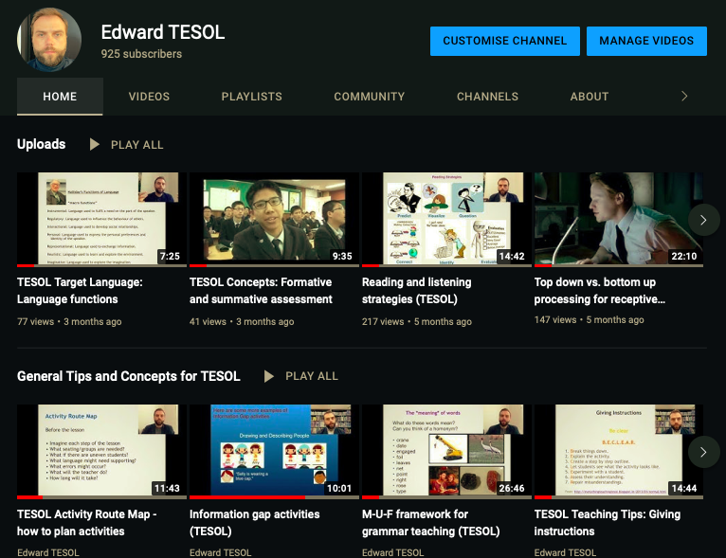
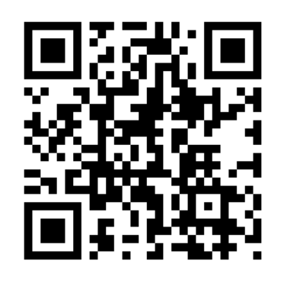
My Youtube:
youtube.com/edpovey
Or search for “Edward TESOL”
Or use your camera with this QR Code:
QR code made with:
qrcode.kaywa.com
(select static code)

Slide 8
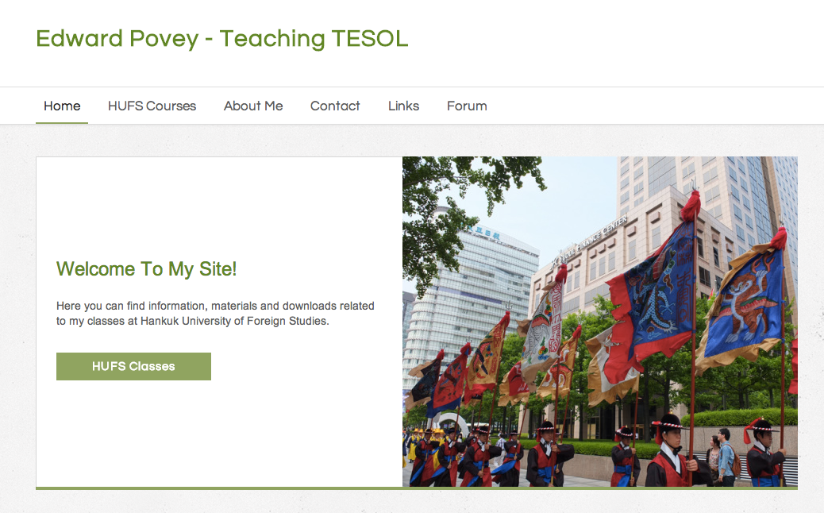
My website: www.edwardtesol.com
I will give you some time to explore.
Go to:
Links page and view some of the resources.
Go to TESOL menu and take a look around!

Slide 9
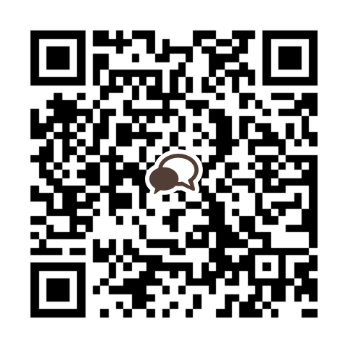
Please join this chat group.
GSTESOL YL LS s23

Slide 10
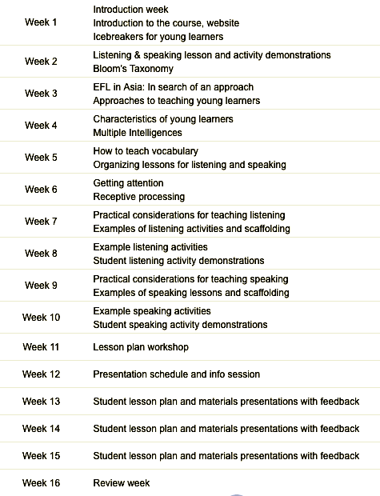
Listening & Speaking for Young Learners
Schedule

Slide 11
Reading assignments (3 examples)
Week 3
Week 4
Week 5

Slide 12
Topic next week:
Listening & speaking lesson and activity demonstrations
There is no reading task due in Week 2.
Reading assignment due week 3 (March 19)
Read chapter 1 from “Teaching English to Children in Asia” by David Paul. See HUFS e-class and my site for the homework task.

