Slide 1
Listening & Speaking
for Young Learners
Review
Speaking activity examples
Modeling and scaffolding
Bloom’s Taxonomy
Reading homework
Email: edpovey@hotmail.co.uk
Website: edwardtesol.com

Slide 2
www.edwardtesol.com

Slide 3
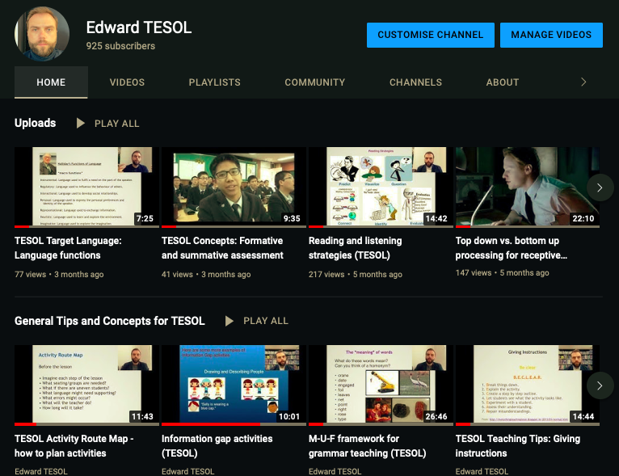
My Youtube: youtube.com/edpovey
- or search for “Edward TESOL”

Slide 4
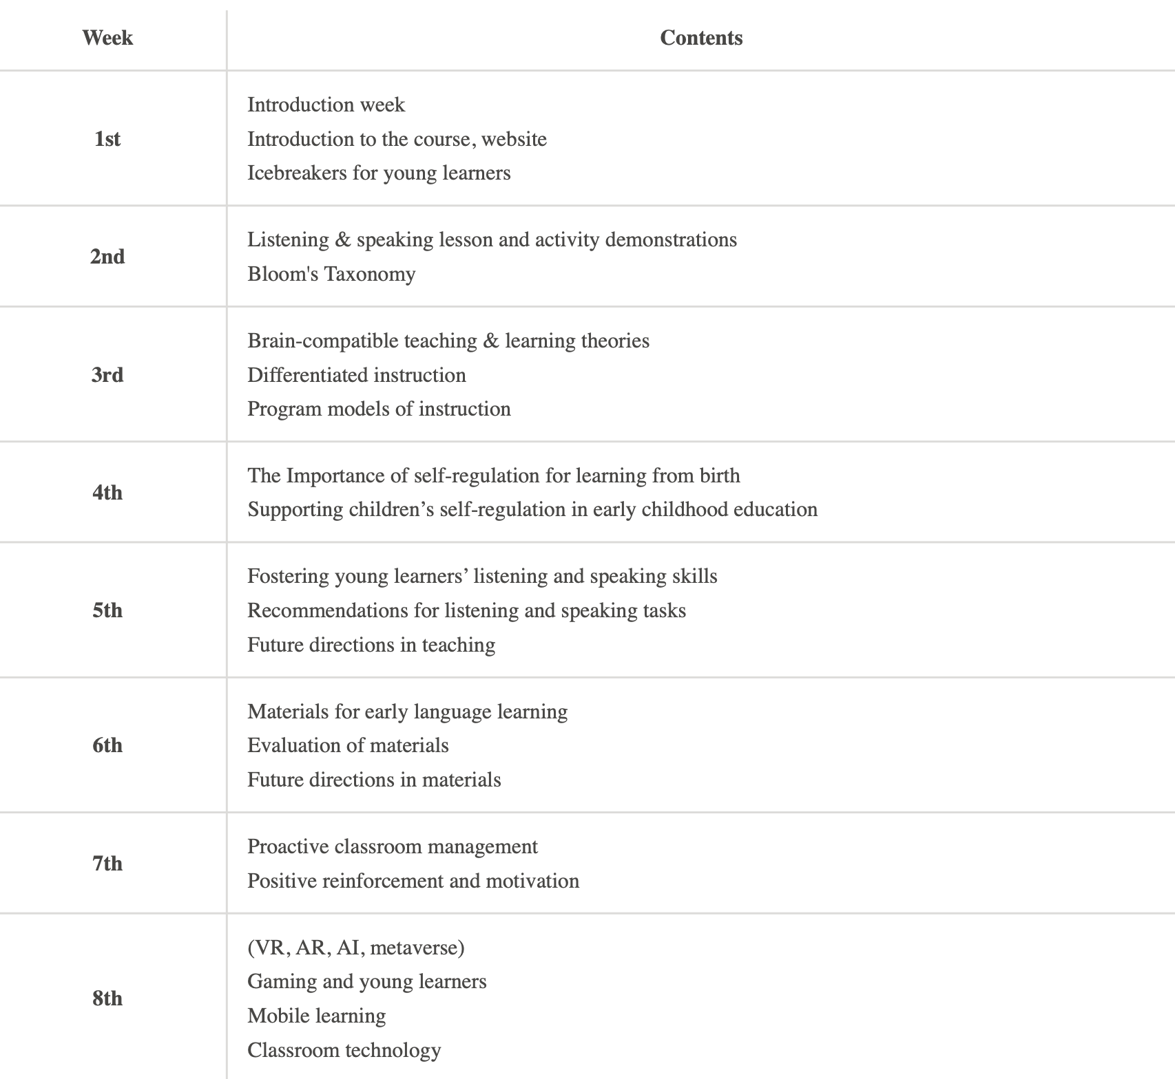
Schedule

Slide 5
Reading assignments (3 examples)
Week 3
Week 4
Week 5

Slide 6
Icebreakers
An 'icebreaker' is an activity, game, or task that is used to warm up the conversation among learners and help them to introduce themselves.
Name Chain game
for remembering names
‘English Edward’,
‘Pirate Peter’......

Slide 7
Icebreakers
Line up game
Line up according to:
How long it takes you to get to HUFS.
The month of your birthday.
What time you went to bed last night.
How many years of teaching experience you have.
Which age Ss you usually teach / want to teach.
http://myparadigmshift.org/101-ways-to-line-up-a-group-a-classic-team-building-and-icebreaker-activity/

Slide 8
Mime Your Name
Think of something you can mime about each letter in your name. For example:
Monster
Ice
Kite
Eagle
= MIKE!
Mime each thing and other students will try to guess what it is.
E-D-W-A-R-D

Slide 9
What are some good questions to ask when we meet someone for the first time?

Slide 10
What
Where
When
Who
Why
How
Which
Icebreakers
Star Game
Here are 5 answers about me.
You need to guess the question!
riding a bike
Oliver
Gwangjang market
18 years
pajeon

Slide 11
Questions
“Modeling” means to show or demonstrate.
What do we need to demonstrate for learners? Make a list.
“Scaffolding” is the support that we provide for students.
What kind of support can we provide for learners?

Slide 12
There are two things teachers need to model.
Modeling
Language
Activities
Steps
Materials
Instructions
Rules
Outcome
Etc.
Language input, Examples
Stories, TPR, Dialogues
Questions + Answers
Pronunciation, Spelling
Etc.

Slide 13
The teacher is a model (but not clothes!)

Slide 14
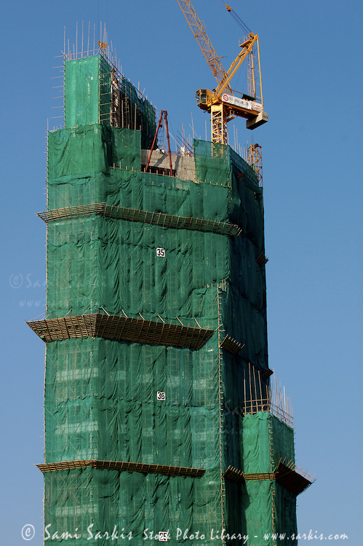
Scaffolding = support
scaffolding from the teacher
scaffolding from the teacher
learner development
Scaffolding in construction
Scaffolding in education

Slide 15
Scaffolding (in education) is the support the teacher provides for the learner. There are many ways to support learners.
visual examples (images, diagrams…)
positive feedback and encouragement
pre-teaching vocabulary
simplifying classroom language
easy tasks —> difficult tasks
using mimes to help comprehension
… and more!

Slide 16
Viewpoints of “scaffolding”
theory
Bruner
Vygotsky
practice
Teachers
guided discovery
caretaker talk
scaffolding
scaffolding
materials
lesson planning
activities
social interaction
ZPD
i+1
Look at this diagram. What does it mean? Discuss with a partner.

Slide 17
Scaffolding
visual examples (images, diagrams…)

Slide 18
Scaffolding
positive feedback and encouragement

Slide 19
Scaffolding
pre-teaching vocabulary

Slide 20
Scaffolding
simplifying classroom language

Slide 21
Scaffolding
using mimes to help comprehension

Slide 22
Question
How are modeling and scaffolding related to each other?

Slide 24
Scaffolding
Modeling

Slide 25
Scaffolding
Modeling
Modeling is a type of scaffolding

Slide 26
Task sequencing. Example: Star Game
1. T explains
2. T models activity with Ss
3. students do the activity
4. T introduces Stage 2
5. students practice/prepare
6. students report to class
T
T-Ss
S-S
T
S-S
Ss-T
What does the triangle shape represent?

Slide 27
Responsibility
The key to student-centered teaching is getting the students involved.
A good teacher does less work than the students at the end of an activity or lesson.
Teacher
Student

Slide 28
Here is a famous quote.
“I” refers to the learner.
“Tell me and I will forget.
Show me and I will remember.
Involve me and I will understand.
Step back and I will act.”
What can we learn from this?
Telling/Explaining is not enough
Showing (modeling) is an important step
Move towards Ss independence
Plan objectives from the Ss perspective

Slide 29
Bloom’s Taxonomy is a classification of levels of thinking. This is useful for designing activities, lesson plans, and asking questions.
Which is more difficult?
1. Remembering information or analysing information?
2. Evaluating information or understanding information?
3. Applying (using information) or creating new information?

Slide 30
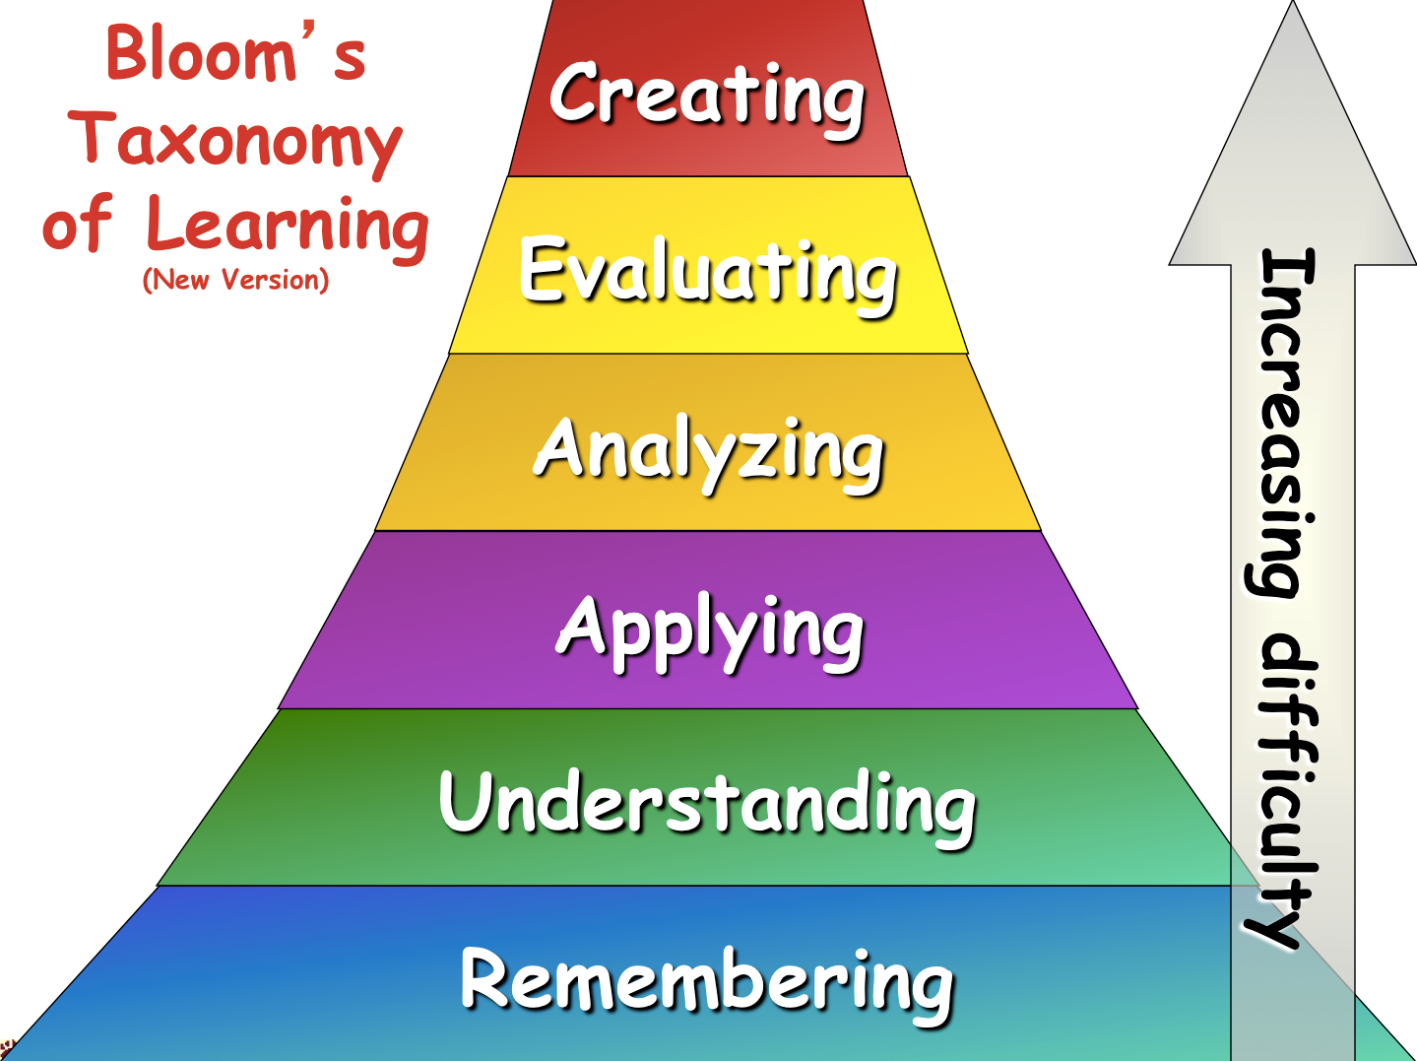

Slide 31
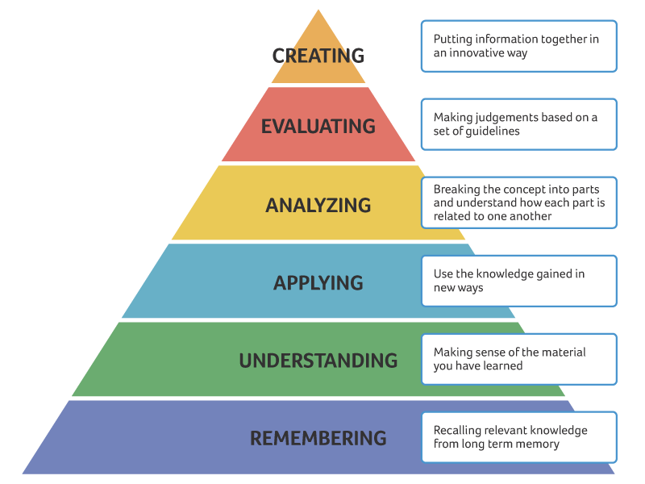
Bloom’s taxonomy of thinking skills
Reflection
(critical
thinking)
_________
Summary

Slide 32
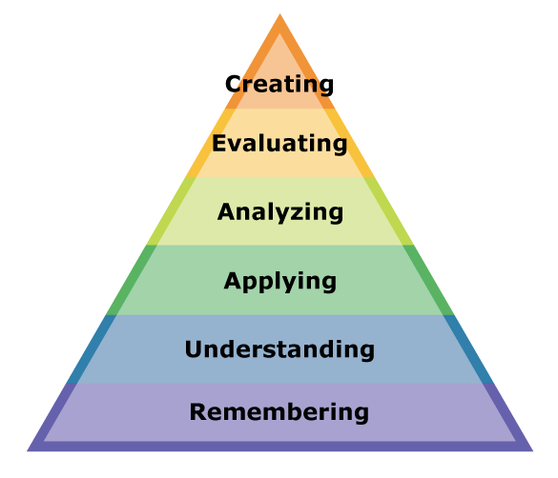
Bloom’s taxonomy of thinking skills
Which level of Bloom’s Taxonomy is each of these tasks? Discuss with your partner.
Compare the sports player in the text with your favorite sports player.
Tell me the year of Yi Sun Shin’s battle that you read in the text.
What does this word mean?
Can you write a new sentence using this word.
Do you agree with this opinion?
Make a new story with the same characters.

Slide 33
Bloom’s Taxonomy
Following Bloom’s Taxonomy, we can create authentic task sequences.
Remember > Comprehend > Apply > Analyze > Evaluate > Create
1. Input
A menu
prices
sections
food
ingredients
drinks
Flashcard game
2. Process
What are the main sections of the menu?
Where are the main meals?
Which meals are expensive?
Categorize worksheet
3. Action
Make an order form with the foods you want to order.
Which foods on the menu are a good deal?
You only have $10!
Recommend food for your friends.

Slide 34
Bloom’s Taxonomy
Following Bloom’s Taxonomy, we can create authentic task sequences.
Remember > Comprehend > Apply > Analyze > Evaluate > Create
1. Input
’s
Apostrophe (possession)
“This is Mike’s book.”
Listen and point.
Read a short story and circle the apostrophes.
2. Process
Write 3 sentences about your friend’s things.
This is Edward’s book.
-
Find the differences
This is Peter’s pen.
She’s happy.
Mike’s in the bedroom.
These are Jane’s books.
3. Action
Write a story about Mike’s room.

Slide 35
Bloom’s Taxonomy
TASK
Choose a topic for your lesson. The topic could be:
a vocabulary set (example: colours - red, blue, yellow…)
a grammar point (example: “to be” verb, comparative…)
a story (example: Goldilocks, Cinderella…)
an expression (example: “I want to be a pilot / doctor / vet”…)
Brainstorm how you would structure a lesson using Bloom’s Taxonomy.
Think about the 3 stages and an activity for each stage:
Remember, Comprehend
Apply, Analyze
Evaluate, Create

Slide 37
Reading assignment due week 3 (March 21)
The reading includes many questions in red text.
Choose any 2 questions and write your answers on the HUFS e-class discussion board. About 1-2 paragraphs for each answer is fine. Include your opinions, ideas and experiences.
Be ready to discuss the reading next week.

