Slide 1
Listening & Speaking
for Young Learners
Review - modeling and scaffolding
Reading review
Differentiated instruction
Bloom’s Taxonomy
Reading homework
Email: edpovey@hotmail.co.uk
Website: edwardtesol.com

Slide 2
“Modeling” means to show or demonstrate.
“Scaffolding” is the support that we provide for students.

Slide 3
What
Where
When
Who
Why
How
Which
Icebreakers
Star Game
Here are 5 answers about me.
You need to guess the question!
riding a bike
Oliver
Gwangjang market
18 years
pajeon

Slide 4
Task sequencing. Example: Star Game
1. T explains
2. T models activity with Ss
3. students do the activity
4. T introduces Stage 2
5. students practice/prepare
6. students report to class
T
T-Ss
S-S
T
S-S
Ss-T
What does the triangle shape represent?

Slide 5
Responsibility
The key to student-centered teaching is getting the students involved.
A good teacher does less work than the students at the end of an activity or lesson.
Teacher
Student

Slide 6
Here is a famous quote.
“I” refers to the learner.
“Tell me and I will forget.
Show me and I will remember.
Involve me and I will understand.
Step back and I will act.”
What can we learn from this?
Telling/Explaining is not enough
Showing (modeling) is an important step
Move towards Ss independence
Plan objectives from the Ss perspective

Slide 7
There are two things teachers need to model.
Modeling
Language
Activities
Steps
Materials
Instructions
Rules
Outcome
Etc.
Language input, Examples
Stories, TPR, Dialogues
Questions + Answers
Pronunciation, Spelling
Etc.

Slide 8
The teacher is a model (but not clothes!)

Slide 9
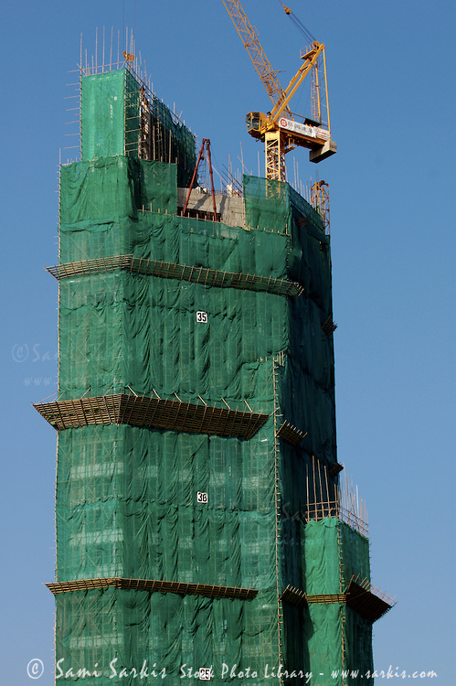
Scaffolding = support
scaffolding from the teacher
scaffolding from the teacher
learner development
Scaffolding in construction
Scaffolding in education

Slide 10
Scaffolding (in education) is the support the teacher provides for the learner. There are many ways to support learners.
visual examples (images, diagrams…)
positive feedback and encouragement
pre-teaching vocabulary
simplifying classroom language
easy tasks —> difficult tasks
using mimes to help comprehension
… and more!

Slide 11
Viewpoints of “scaffolding”
theory
Bruner
Vygotsky
practice
Teachers
guided discovery
caretaker talk
scaffolding
scaffolding
materials
lesson planning
activities
social interaction
ZPD
i+1
Look at this diagram. What does it mean? Discuss with a partner.

Slide 12
Scaffolding
visual examples (images, diagrams…)

Slide 13
Scaffolding
positive feedback and encouragement

Slide 14
Scaffolding
pre-teaching vocabulary

Slide 15
Scaffolding
simplifying classroom language

Slide 16
Scaffolding
using mimes to help comprehension

Slide 17
Question
How are modeling and scaffolding related to each other?

Slide 19
Scaffolding
Modeling

Slide 20
Scaffolding
Modeling
Modeling is a type of scaffolding

Slide 24
Differentiating Instruction
https://www.youtube.com/watch?v=h7-D3gi2lL8

Slide 25
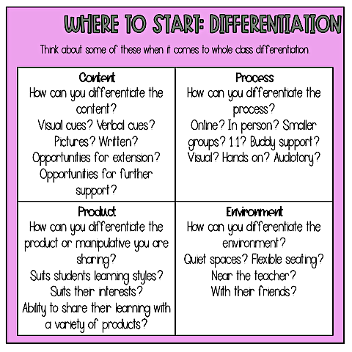
Differentiating Instruction

Slide 26
Differentiating Instruction

Slide 27
Differentiating Instruction

Slide 28
Story book lesson with differentiated instruction
Task: Choose a story book. Read it and decide the main theme or focus.
What are your ideas for organizing learning and giving options based on the differentiated factors we have discussed?
CONTENT - PROCESS - PRODUCT - LEARNING ENVIRONMENT

Slide 29
Speaking lesson - target language
Q+A patterns
Grammar
Functions
Situations
Are you…
Do you…
Can you…
Did you…
What’s…
Where…
…
…
…
Modals
Past tense
Superlative
Prepositions
Adverbs
Tag questions
…
…
…
Agreeing
Suggesting
Clarifying
Apologising
Explaining
Complaining
…
…
…
Bank
Restaurant
Train station
Cinema
Supermarket
Hotel
…
…
…
Task: Choose target language. Brainstorm example expressions if needed.
What are your ideas for organizing learning and giving options based on the differentiated factors we have discussed?
CONTENT - PROCESS - PRODUCT - LEARNING ENVIRONMENT

Slide 30
Learning Stations / Station Rotation
https://www.youtube.com/watch?v=V_iu_aQCiyk

Slide 31
Learning Stations / Station Rotation
https://www.youtube.com/watch?v=Kg38A1ggYiE

Slide 32
Kagan Structures

Slide 33
Kagan Structures
https://www.youtube.com/watch?v=D-yzgJtgVrg

Slide 34
Kagan Structures
https://youtu.be/o4n60DpwYOg?si=mpaWxHFePRwgnqrW

Slide 35
Kagan Structures
https://www.youtube.com/watch?v=t9H_pVwX-xY

Slide 36
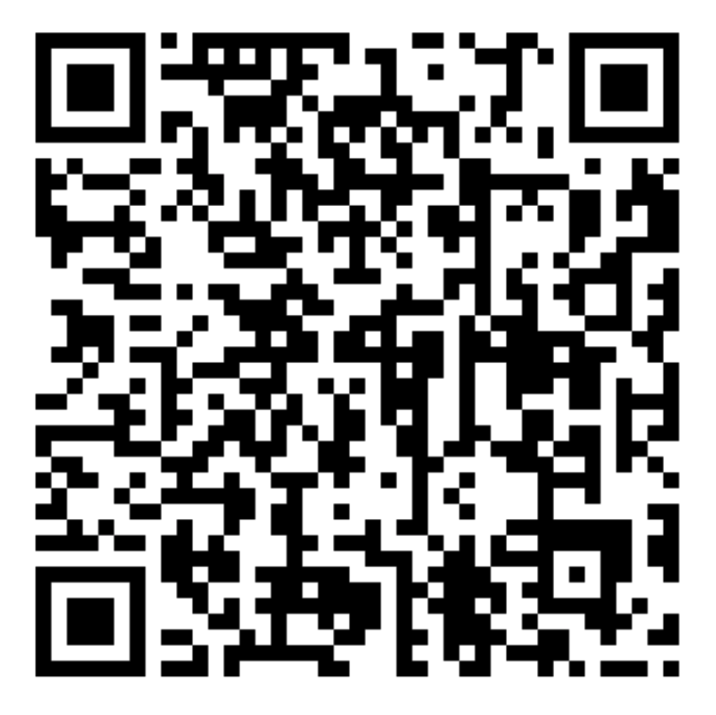
Kagan Structures - Task
Go here and choose one of the included structures to read about.
Share with your partner about the structure and how you might use it in the class.

Slide 37
Bloom’s Taxonomy is a classification of levels of thinking. This is useful for designing activities, lesson plans, and asking questions.
Which is more difficult?
1. Remembering information or analysing information?
2. Evaluating information or understanding information?
3. Applying (using information) or creating new information?

Slide 38
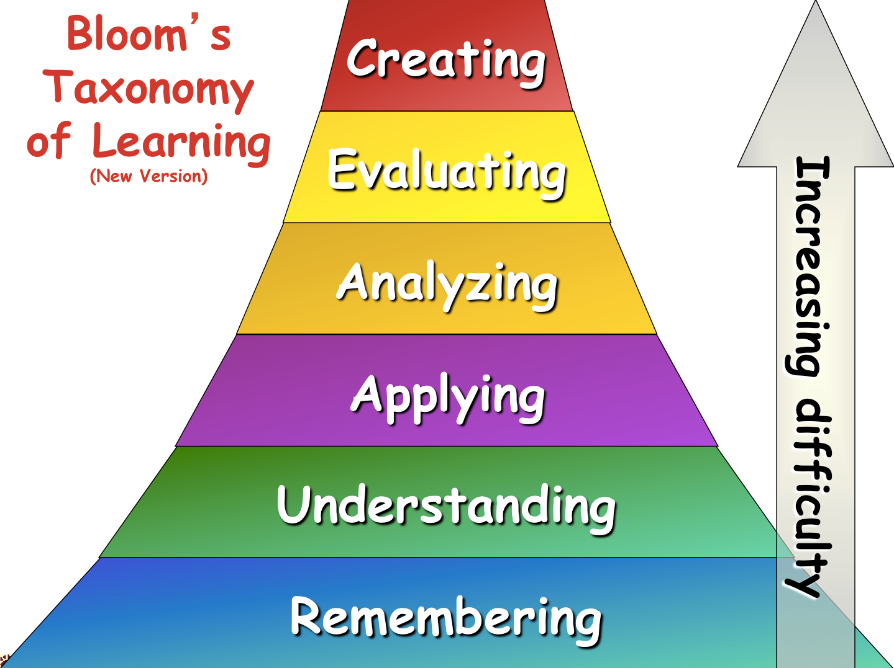

Slide 39
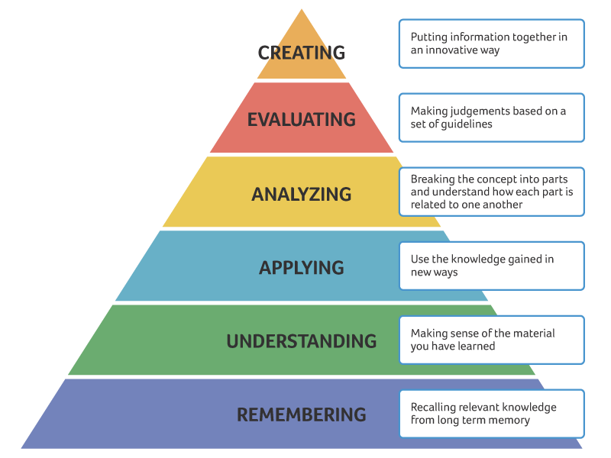
Bloom’s taxonomy of thinking skills
Reflection
(critical
thinking)
_________
Summary

Slide 40
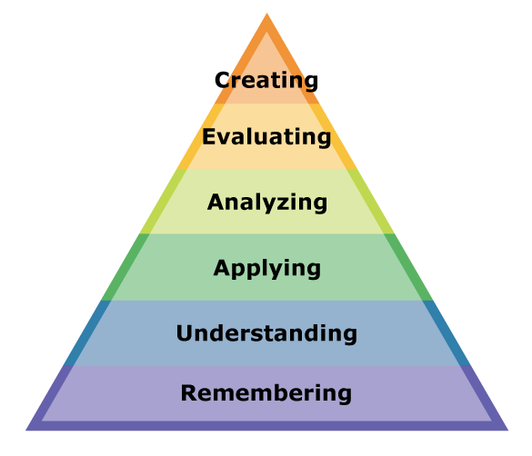
Bloom’s taxonomy of thinking skills
Which level of Bloom’s Taxonomy is each of these tasks? Discuss with your partner.
Compare the sports player in the text with your favorite sports player.
Tell me the year of Yi Sun Shin’s battle that you read in the text.
What does this word mean?
Can you write a new sentence using this word.
Do you agree with this opinion?
Make a new story with the same characters.

Slide 41
Bloom’s Taxonomy
Following Bloom’s Taxonomy, we can create authentic task sequences.
Remember > Comprehend > Apply > Analyze > Evaluate > Create
1. Input
A menu
prices
sections
food
ingredients
drinks
Flashcard game
2. Process
What are the main sections of the menu?
Where are the main meals?
Which meals are expensive?
Categorize worksheet
3. Action
Make an order form with the foods you want to order.
Which foods on the menu are a good deal?
You only have $10!
Recommend food for your friends.

Slide 42
Bloom’s Taxonomy
Following Bloom’s Taxonomy, we can create authentic task sequences.
Remember > Comprehend > Apply > Analyze > Evaluate > Create
1. Input
’s
Apostrophe (possession)
“This is Mike’s book.”
Listen and point.
Read a short story and circle the apostrophes.
2. Process
Write 3 sentences about your friend’s things.
This is Edward’s book.
-
Find the differences
This is Peter’s pen.
She’s happy.
Mike’s in the bedroom.
These are Jane’s books.
3. Action
Write a story about Mike’s room.

Slide 43
Bloom’s Taxonomy
TASK
Choose a topic for your lesson. The topic could be:
a vocabulary set (example: colours - red, blue, yellow…)
a grammar point (example: “to be” verb, comparative…)
a story (example: Goldilocks, Cinderella…)
an expression (example: “I want to be a pilot / doctor / vet”…)
Brainstorm how you would structure a lesson using Bloom’s Taxonomy.
Think about the 3 stages and an activity for each stage:
Remember, Comprehend
Apply, Analyze
Evaluate, Create

Slide 44
Reading assignment due week 4 (March 26)
The reading includes many questions in red text.
Choose any 2 questions and write your answers on the HUFS e-class discussion board. About 1-2 paragraphs for each answer is fine. Include your opinions, ideas and experiences.
Be ready to discuss the reading next week.

