Slide 1
Listening & Speaking
for Young Learners
Review
Bloom’s Taxonomy (concept)
Gradual release of responsibility (GRR) model (concept)
Think aloud strategy (technique)
Class123 app (technology)
Reading review
Exit slips (technique)
About next week
Email: edpovey@hotmail.co.uk
Website: edwardtesol.com

Slide 3
Language learner types by Keith Willing (1987):
Convergers are solitary, pragmatic, independent and confident in their abilities. They avoid groups.
Conformists prefer to emphasize learning about language over learning to use it. They tend to be dependent on those in authority and are perfectly happy to work in non-communicative classrooms.
Concrete learners like to learn from direct experience in the classroom. They are pragmatic and value the practical use of language. They eagerly participate in group work.
Communicative are comfortable out of class and show a willingness to take risks. They are much more interested in social interaction with other speakers of the language than they are with analysis of how the language works.
Which one are you?

Slide 6
Differentiating Instruction
CONTENT - topics, materials, resources
PROCESS - activities, tasks, interactions, skills
PRODUCT - outcomes, goals, end results
LEARNING ENVIRONMENT - groups, classroom set up

Slide 7
Speaking lesson - target language
Q+A patterns
Grammar
Functions
Situations
Are you…
Do you…
Can you…
Did you…
What’s…
Where…
…
…
…
Modals
Past tense
Superlative
Prepositions
Adverbs
Tag questions
…
…
…
Agreeing
Suggesting
Clarifying
Apologising
Explaining
Complaining
…
…
…
Bank
Restaurant
Train station
Cinema
Supermarket
Hotel
…
…
…
Task: Choose target language. Brainstorm example expressions if needed.
What are your ideas for organizing learning and giving options based on the differentiated factors we have discussed?
CONTENT - PROCESS - PRODUCT - LEARNING ENVIRONMENT

Slide 9
Learning Stations / Station Rotation
https://www.youtube.com/watch?v=V_iu_aQCiyk

Slide 10
Learning Stations / Station Rotation
https://www.youtube.com/watch?v=Kg38A1ggYiE

Slide 11
Using anchor activities to develop learning stations

Slide 13
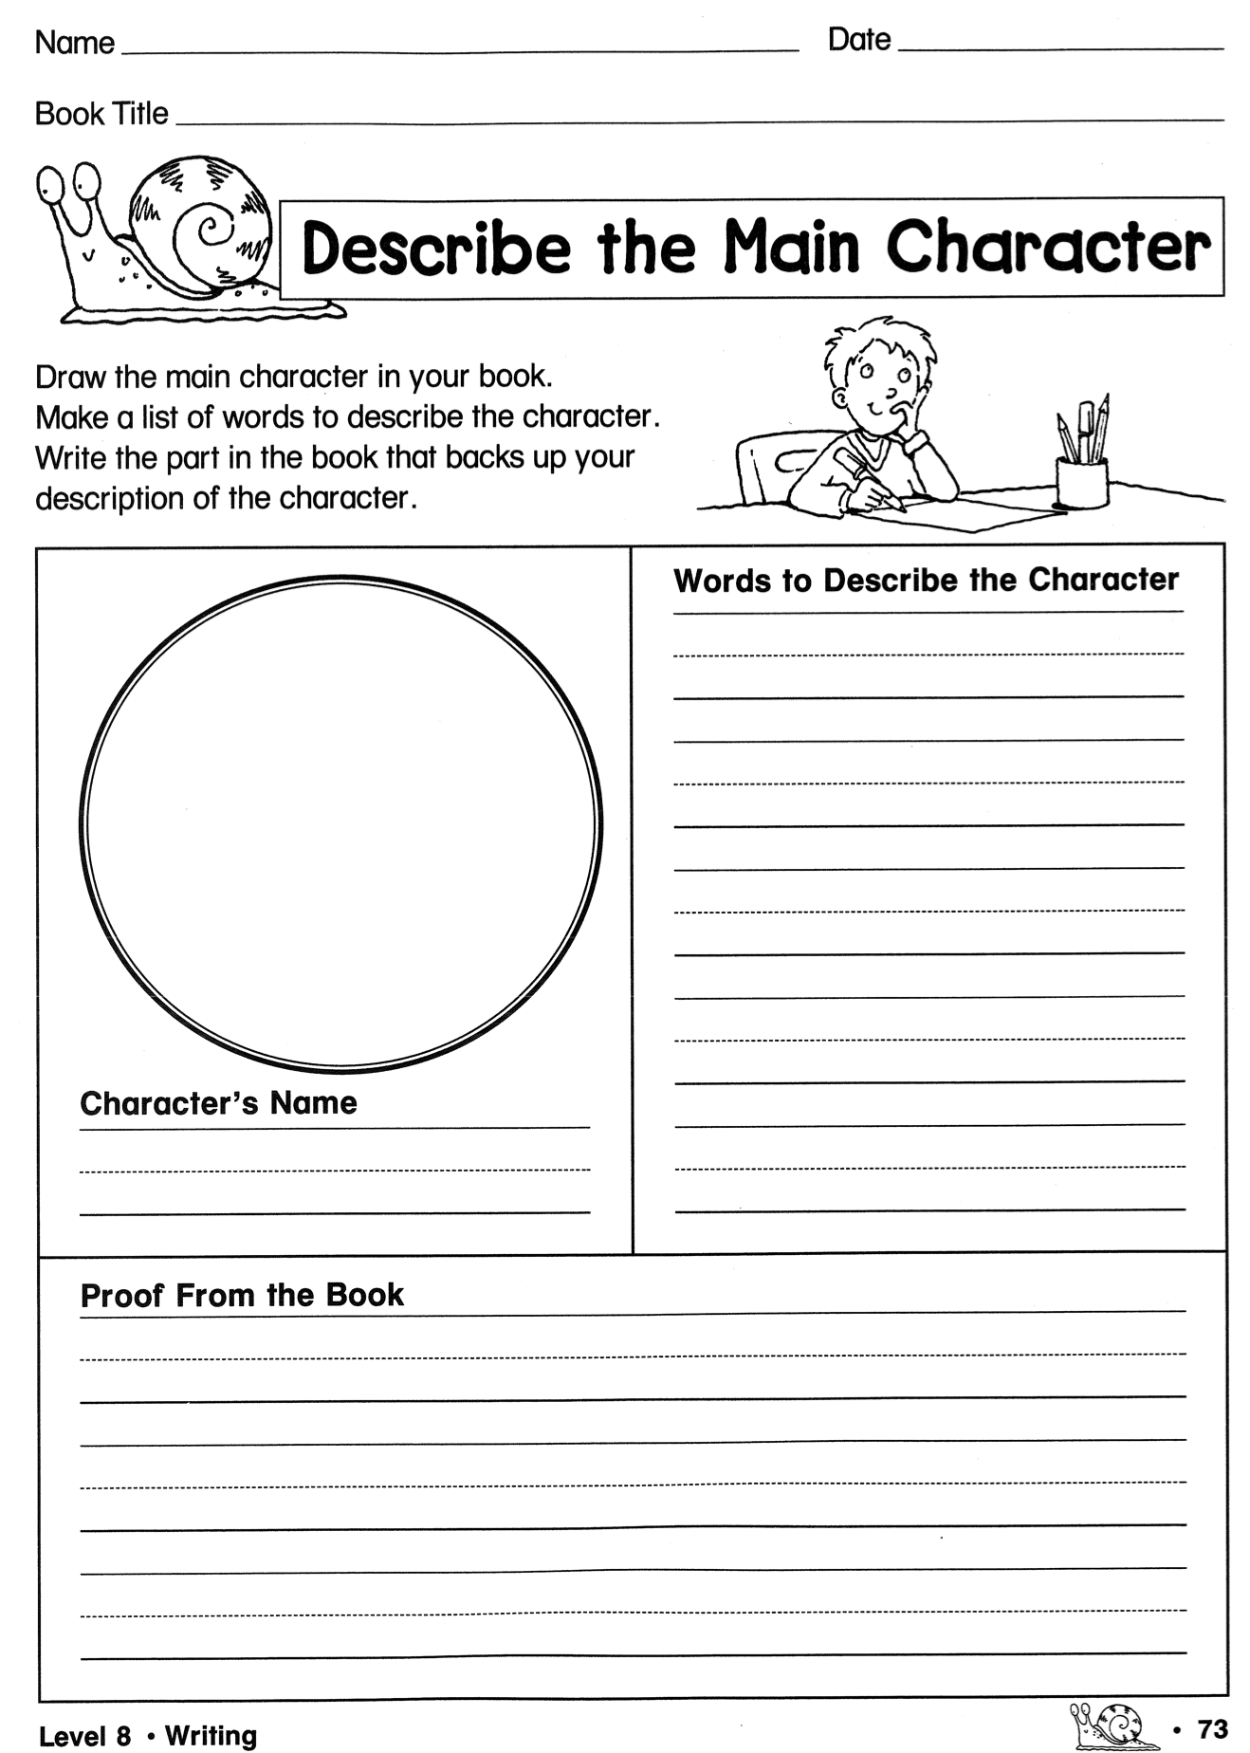
https://www.edwardtesol.com/materials-downloads.html
Anchor Activities:
Extensive reading & Book reports
You can download over 100 book report worksheets at the link above.

Slide 14
Kagan Structures

Slide 15
Kagan Structures
https://www.youtube.com/watch?v=t9H_pVwX-xY

Slide 16
Kagan Structures - Task
Go here and choose one of the included structures to read about.
Share with your partner about the structure and how you might use it in the class.

Slide 17
Diverse assessments

Slide 19
Bloom’s Taxonomy is a classification of levels of thinking. This is useful for designing activities, lesson plans, and asking questions.
Which is more difficult?
1. Remembering information or analyzing information?
2. Evaluating information or understanding information?
3. Applying (using information) or creating new information?

Slide 20
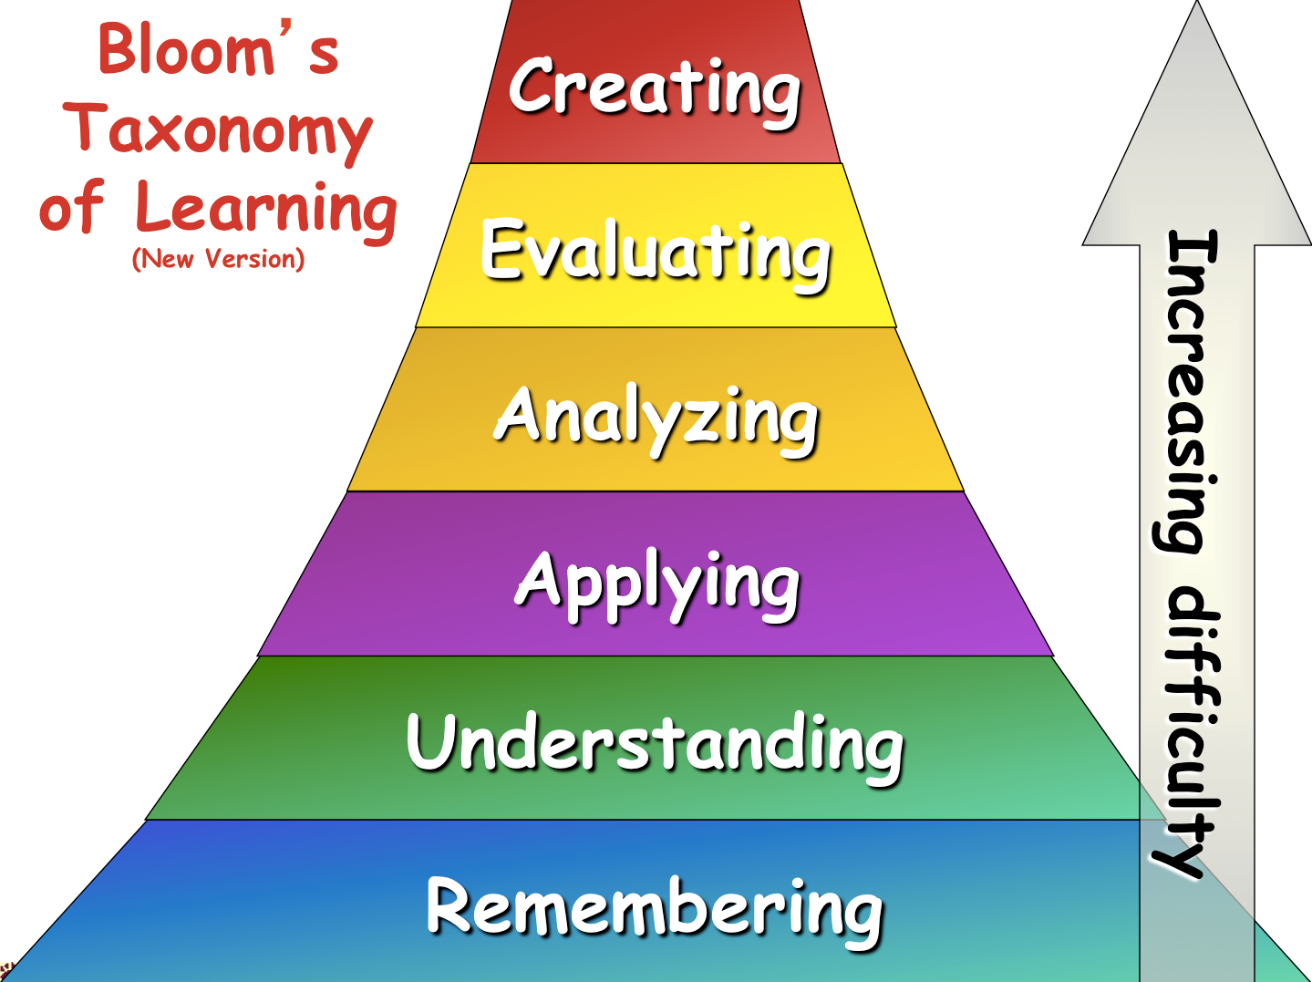

Slide 21
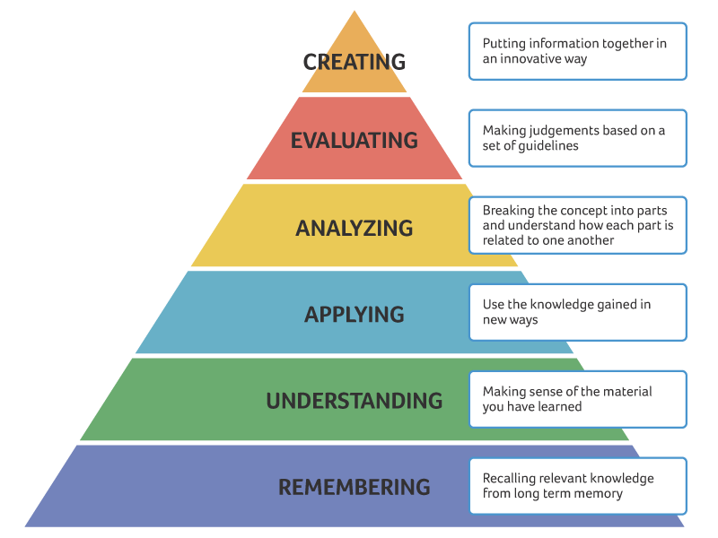
Bloom’s taxonomy of thinking skills
Reflection
(critical
thinking)
_________
Summary

Slide 22
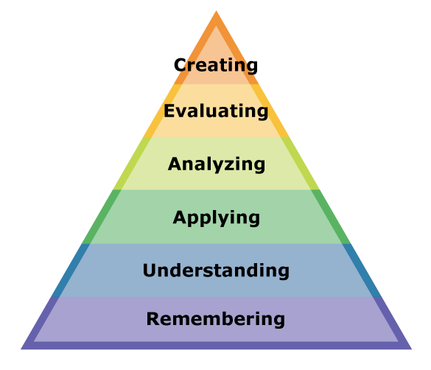
Bloom’s taxonomy of thinking skills
Which level of Bloom’s Taxonomy is each of these tasks? Discuss with your partner.
Compare the sports player in the text with your favorite sports player.
Tell me the year of Yi Sun Shin’s battle that you read in the text.
What does this word mean?
Can you write a new sentence using this word.
Do you agree with this opinion?
Make a new story with the same characters.

Slide 23
Bloom’s Taxonomy
Following Bloom’s Taxonomy, we can create authentic task sequences.
Remember > Comprehend > Apply > Analyze > Evaluate > Create
1. Input
A menu
prices
sections
food
ingredients
drinks
Flashcard game
2. Process
What are the main sections of the menu?
Where are the main meals?
Which meals are expensive?
Categorize worksheet
3. Action
Make an order form with the foods you want to order.
Which foods on the menu are a good deal?
You only have $10!
Recommend food for your friends.

Slide 24
Bloom’s Taxonomy
Following Bloom’s Taxonomy, we can create authentic task sequences.
Remember > Comprehend > Apply > Analyze > Evaluate > Create
1. Input
’s
Apostrophe (possession)
“This is Mike’s book.”
Listen and point.
Read a short story and circle the apostrophes.
2. Process
Write 3 sentences about your friend’s things.
This is Edward’s book.
-
Find the differences
This is Peter’s pen.
She’s happy.
Mike’s in the bedroom.
These are Jane’s books.
3. Action
Write a story about Mike’s room.

Slide 25
Bloom’s Taxonomy
TASK
Choose a topic for your lesson. The topic could be:
a vocabulary set (example: colours - red, blue, yellow…)
a grammar point (example: “to be” verb, comparative…)
a story (example: Goldilocks, Cinderella…)
an expression (example: “I want to be a pilot / doctor / vet”…)
Brainstorm how you would structure a lesson using Bloom’s Taxonomy.
Think about the 3 stages and an activity for each stage:
Remember, Comprehend
Apply, Analyze
Evaluate, Create

Slide 26
Week 4 reading assignment
Let’s share your answers to the questions in red.

Slide 27
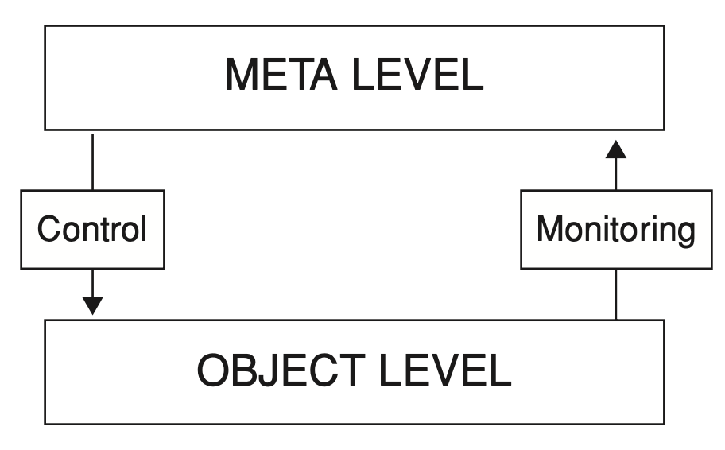
Model of metacognition
= Strategies
= Doing the task

Slide 28
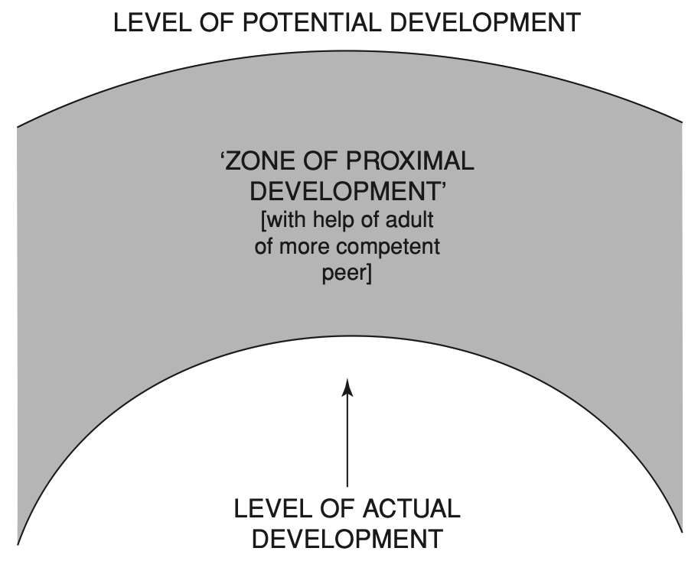
Vygotsky’s ‘Zone of Proximal Development’

Slide 29
Modeling & Scaffolding

Slide 30
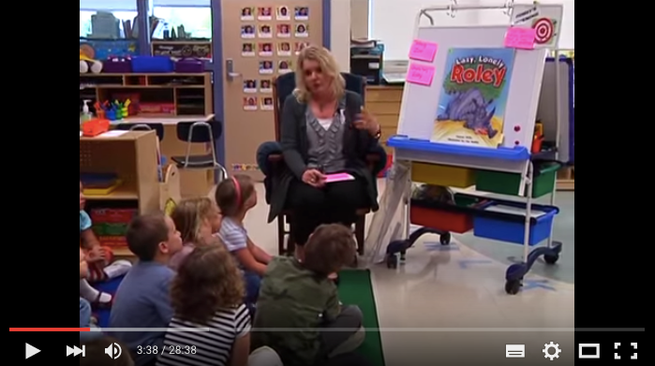
‘Think aloud’
strategy for modeling predicting.
https://youtu.be/5V1g1cp5PVk?t=1m42s
‘Think aloud’ strategy can be used for…
Punctuation, spelling, phonics…
Sentence construction, paragraph writing…
Deciphering new vocabulary, L/R comprehension….
And more
An example with reading: https://www.youtube.com/watch?v=-nkwUtPc_lQ

Slide 31
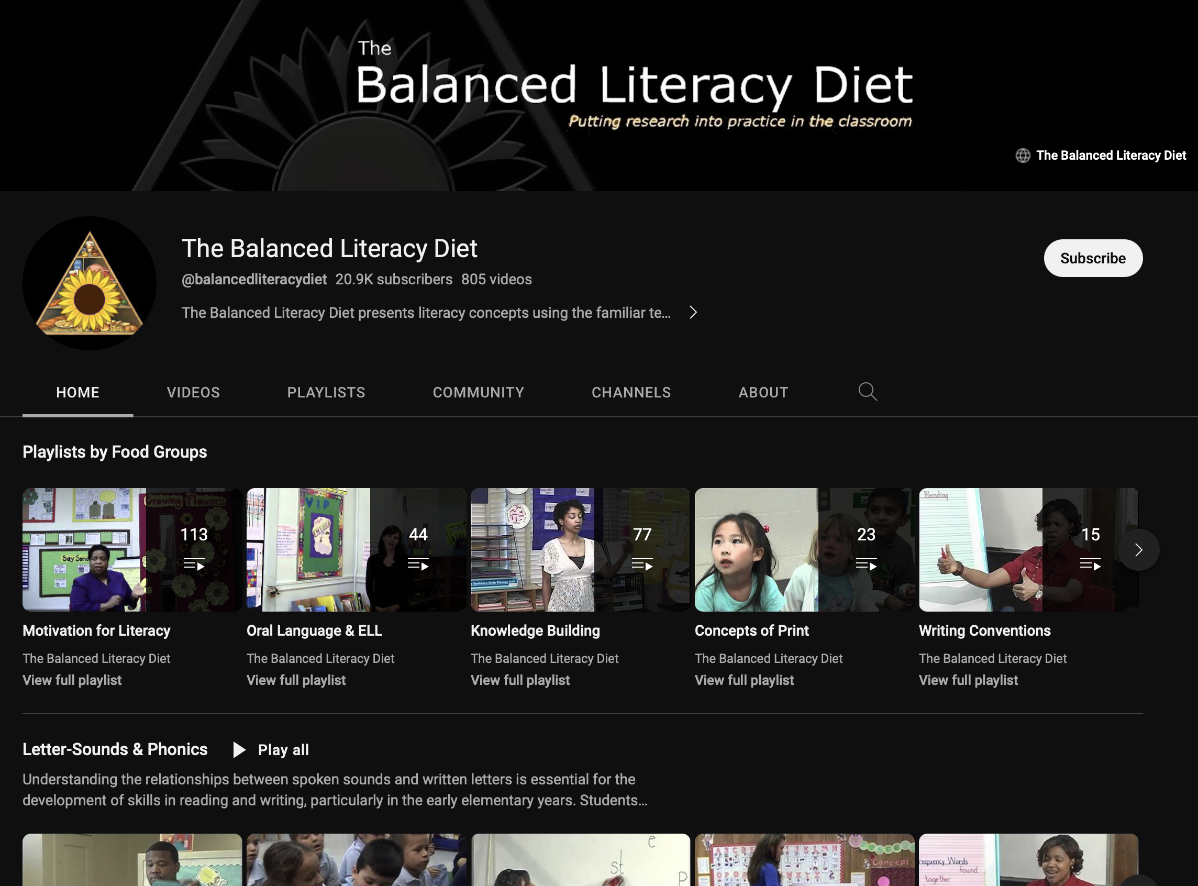
Balanced Literacy Diet
This is a fantastic Youtube channel for everything to do with literacy teaching. Lots of good techniques + strategies.

Slide 32
Class123 (NHN Edu Corp.)
Class123 is a free behavior management tool for your class. Fill your classroom with warm praises. Start with Class123!
https://class123.ac/ (service down)
https://www.youtube.com/watch?v=G5b2_1G3LdE

Slide 33
Class123
https://youtu.be/on2tqv3qu5s

Slide 34
Class Dojo is a similar service.

Slide 35
The most interesting topic today. Why?!

Slide 36
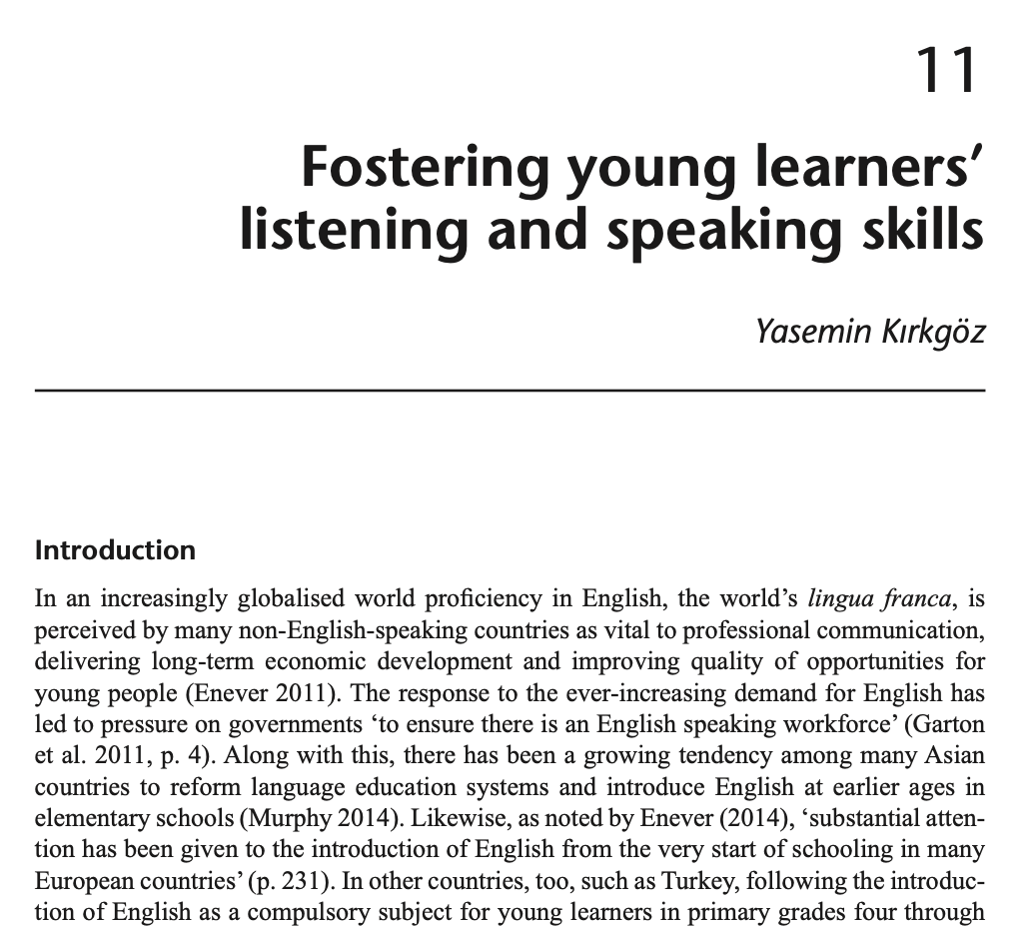
Reading assignment due week 5 (April 4)
The reading includes many questions in red text.
Choose any 2 questions and write your answers on the HUFS e-class discussion board. Include your opinions, ideas and experiences.
Be ready to discuss the reading next week.

Slide 37
What is TPR? = Total Physical Response
physical movement is used to react to verbal input
“Listen and respond”
best with young/beginner students supported by other methods
can be used with expressions, vocabulary, grammar, stories, songs, role plays and so on

Slide 38
Total Physical Response
Why is TPR effective?
Focus on input
Focus on comprehension
Focus on meaning
Listening before production
Similar to natural acquisition
Acquisition (unconscious) over learning (conscious)
Reduces stress and inhibition
Teacher can check responses

Slide 39
Total Physical Response
How to use in the classroom…
T/F or guessing games (e.g. vocabulary)
Team games (competition or cooperation)
Speed games (time limit)
Use with other materials (flashcards, realia…)
Acting and retelling stories
Checking comprehension of songs

Slide 40
Example with grammar focus
Clapping
Game
one dog
two dogs
noticing + TPR
I saw a…
I saw some…
tiger
bear
bird
cow
one cat
two cats

Slide 41
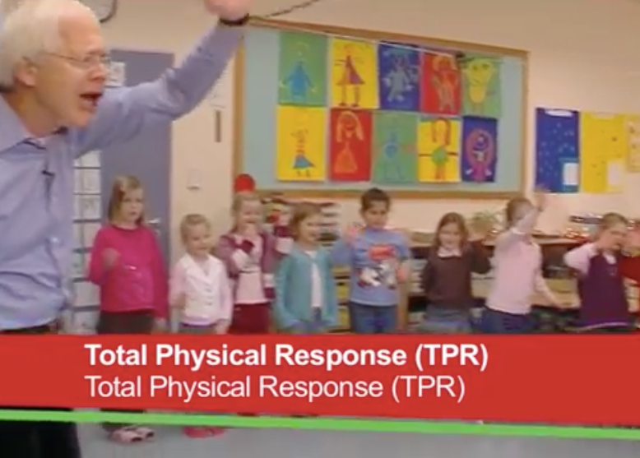
What does the teacher do differently at the beginning and at the end of the TPR activity?
How is TPR used as a step within the lesson?
https://www.youtube.com/watch?v=bkMQXFOqyQA

Slide 42
What does the teacher do differently at the beginning and at the end of the TPR activity?
How is TPR used as a step within the lesson?

Slide 43
What does the teacher do differently at the beginning and at the end of the TPR activity?
Say expression and show the actions
Say expression without showing action (take away scaffolding)
Mix the order of expressions
(Not included) Ask a student to say the expression
How is TPR used as a step within the lesson?
TPR is a scaffolding step to introduce the textbook expressions before opening the textbook. This has the benefit of pre-teaching meaning and giving exposure before the textbook listening activity.

Slide 44
TPR
Let’s mime ‘Buying ice cream’ with TPR
What do we do? 1, 2, 3, 4?
How to do this action game:
1. Choose a situation and the commands
2. Make a list
3. Show the action and say the command
4. Repeat the actions several times
5. Stop doing the actions to check learners understand

Slide 45
www.readingrockets.org
Task: go to https://www.readingrockets.org/strategies
Choose one of the tasks you are unfamiliar with. Take a look and then describe the task to a partner.

Slide 46
The most interesting topic so far. Why?!

Slide 47
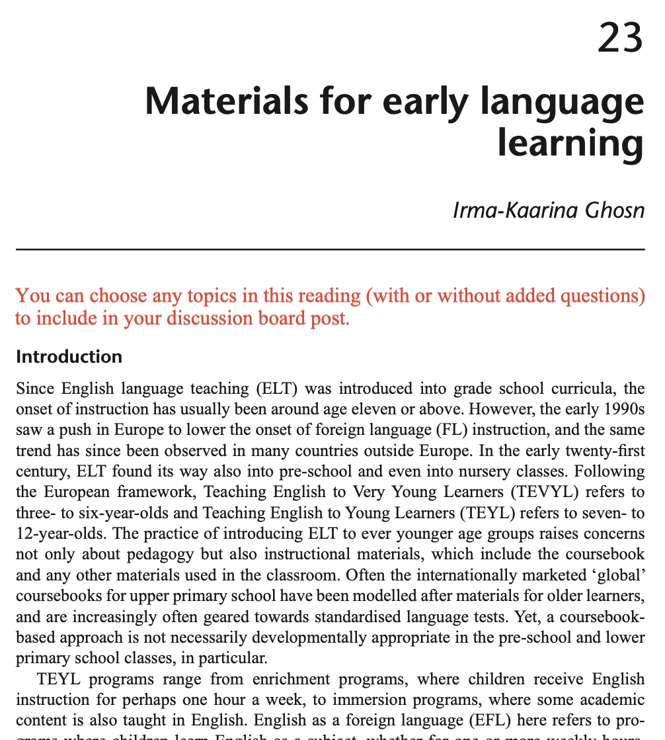
Reading assignment due week 6 (April 9)
The reading includes many questions in red text.
Choose any 2 questions and write your answers on the HUFS e-class discussion board. Include your opinions, ideas and experiences.
Be ready to discuss the reading next week.

