Slide 1
Listening & Speaking
for Young Learners
Review
Bloom’s Taxonomy
Gradual release of responsibility (GRR) model
Reading review
TPR
About next week
Email: edpovey@hotmail.co.uk
Website: edwardtesol.com

Slide 2
Self-directed learning
https://www.youtube.com/watch?v=5MvQoDGvG10

Slide 3
Learning Stations / Station Rotation
https://www.youtube.com/watch?v=Kg38A1ggYiE

Slide 4
Kagan Structures

Slide 5
Diverse assessments

Slide 7
Bloom’s Taxonomy is a classification of levels of thinking. This is useful for designing activities, lesson plans, and asking questions.
Which is more difficult?
1. Remembering information or analyzing information?
2. Evaluating information or understanding information?
3. Applying (using information) or creating new information?

Slide 8
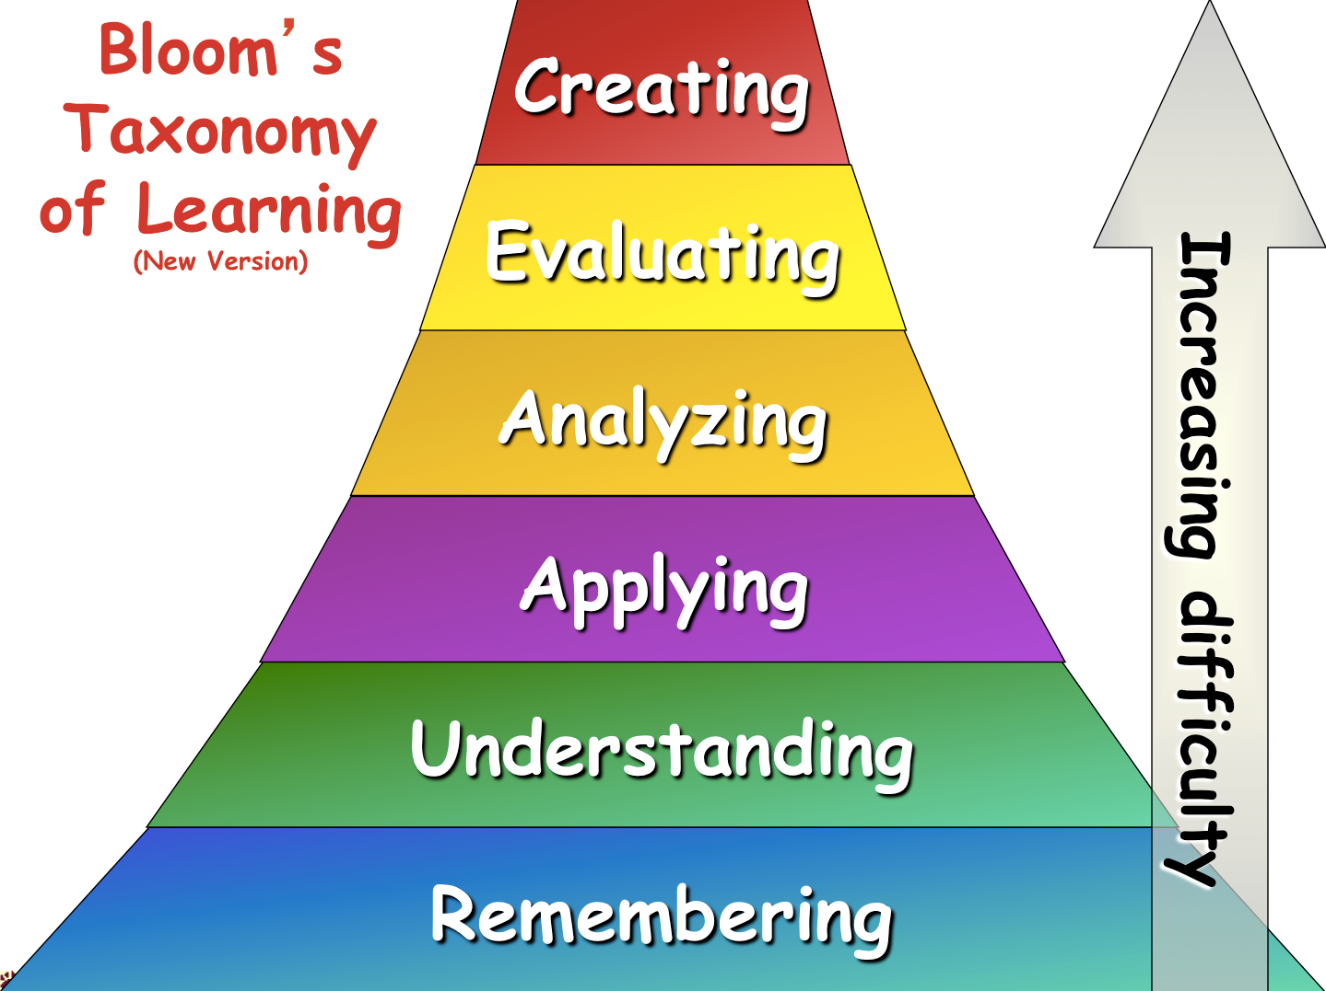

Slide 9
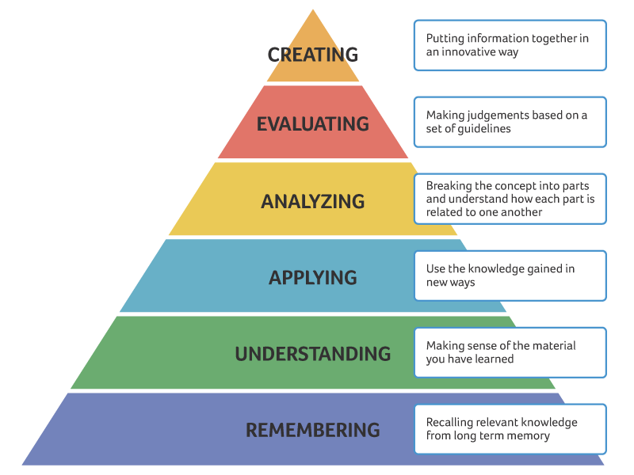
Bloom’s taxonomy of thinking skills
Reflection
(critical
thinking)
_________
Summary

Slide 10
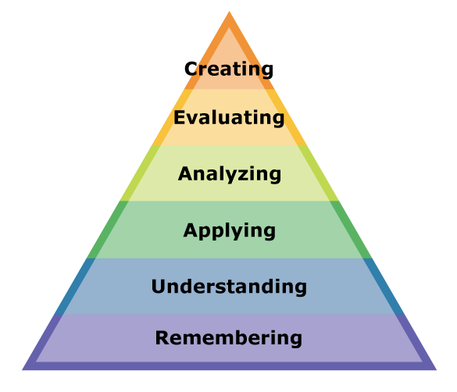
Bloom’s taxonomy of thinking skills
Which level of Bloom’s Taxonomy is each of these tasks? Discuss with your partner.
Compare the sports player in the text with your favorite sports player.
Tell me the year of Yi Sun Shin’s battle that you read in the text.
What does this word mean?
Can you write a new sentence using this word.
Do you agree with this opinion?
Make a new story with the same characters.

Slide 11
Bloom’s Taxonomy
Following Bloom’s Taxonomy, we can create authentic task sequences.
Remember > Comprehend > Apply > Analyze > Evaluate > Create
1. Input
A menu
prices
sections
food
ingredients
drinks
Flashcard game
2. Process
What are the main sections of the menu?
Where are the main meals?
Which meals are expensive?
Categorize worksheet
3. Action
Make an order form with the foods you want to order.
Which foods on the menu are a good deal?
You only have $10!
Recommend food for your friends.

Slide 12
Bloom’s Taxonomy
Following Bloom’s Taxonomy, we can create authentic task sequences.
Remember > Comprehend > Apply > Analyze > Evaluate > Create
1. Input
’s
Apostrophe (possession)
“This is Mike’s book.”
Listen and point.
Read a short story and circle the apostrophes.
2. Process
Write 3 sentences about your friend’s things.
This is Edward’s book.
-
Find the differences
This is Peter’s pen.
She’s happy.
Mike’s in the bedroom.
These are Jane’s books.
3. Action
Write a story about Mike’s room.

Slide 13
Bloom’s Taxonomy
TASK
Choose a topic for your lesson. The topic could be:
a vocabulary set (example: colours - red, blue, yellow…)
a grammar point (example: “to be” verb, comparative…)
a story (example: Goldilocks, Cinderella…)
an expression (example: “I want to be a pilot / doctor / vet”…)
Brainstorm how you would structure a lesson using Bloom’s Taxonomy.
Think about the 3 stages and an activity for each stage:
Remember, Comprehend
Apply, Analyze
Evaluate, Create

Slide 14
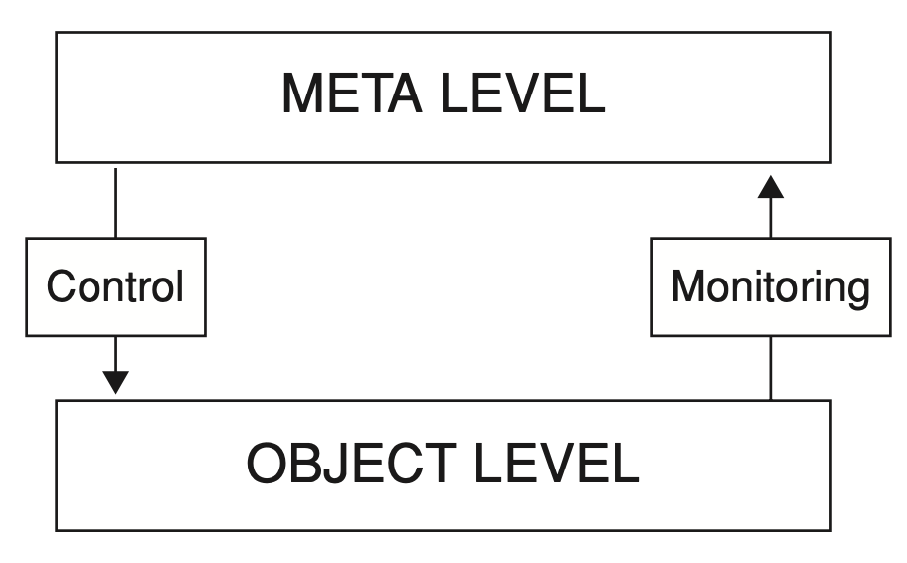
Model of metacognition
= Strategies
= Doing the task

Slide 15
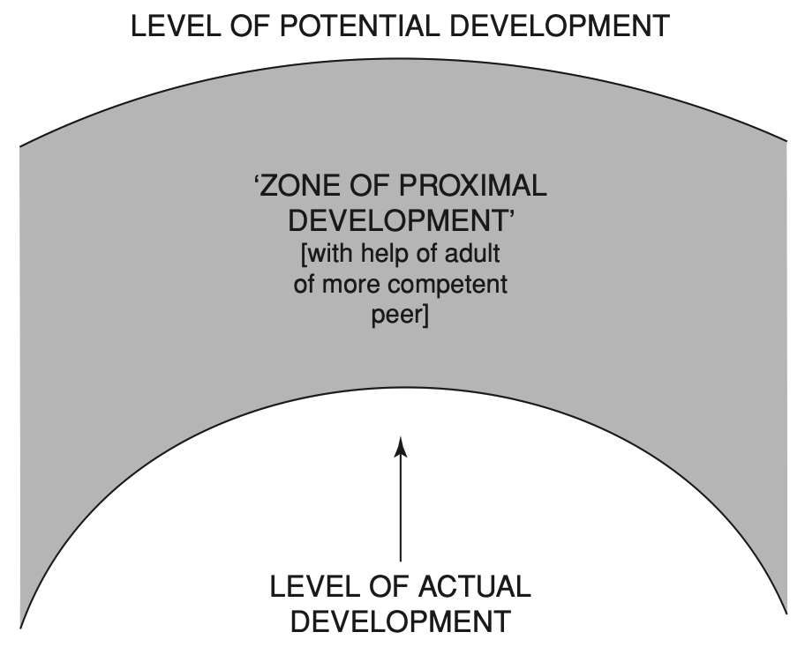
Vygotsky’s ‘Zone of Proximal Development’

Slide 16
Modeling & Scaffolding

Slide 17
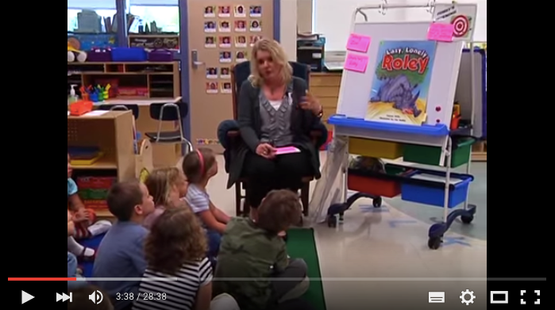
‘Think aloud’
strategy for modeling predicting.
https://youtu.be/5V1g1cp5PVk?t=1m42s
‘Think aloud’ strategy can be used for…
Punctuation, spelling, phonics…
Sentence construction, paragraph writing…
Deciphering new vocabulary, L/R comprehension….
And more
An example with reading: https://www.youtube.com/watch?v=-nkwUtPc_lQ

Slide 18
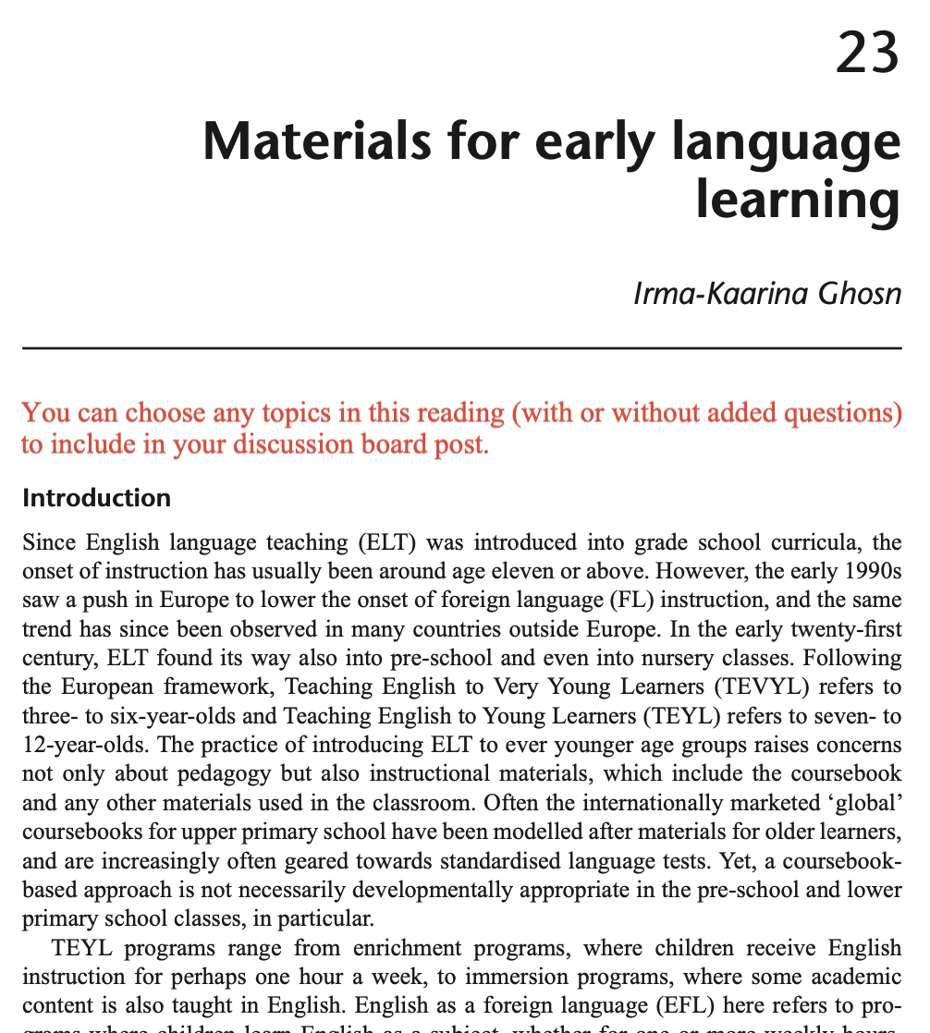
Reading assignment due week 6 (April 11)
The reading includes many questions in red text.
Choose any 2 questions and write your answers on the HUFS e-class discussion board. Include your opinions, ideas and experiences.
Be ready to discuss the reading next week.

Slide 19
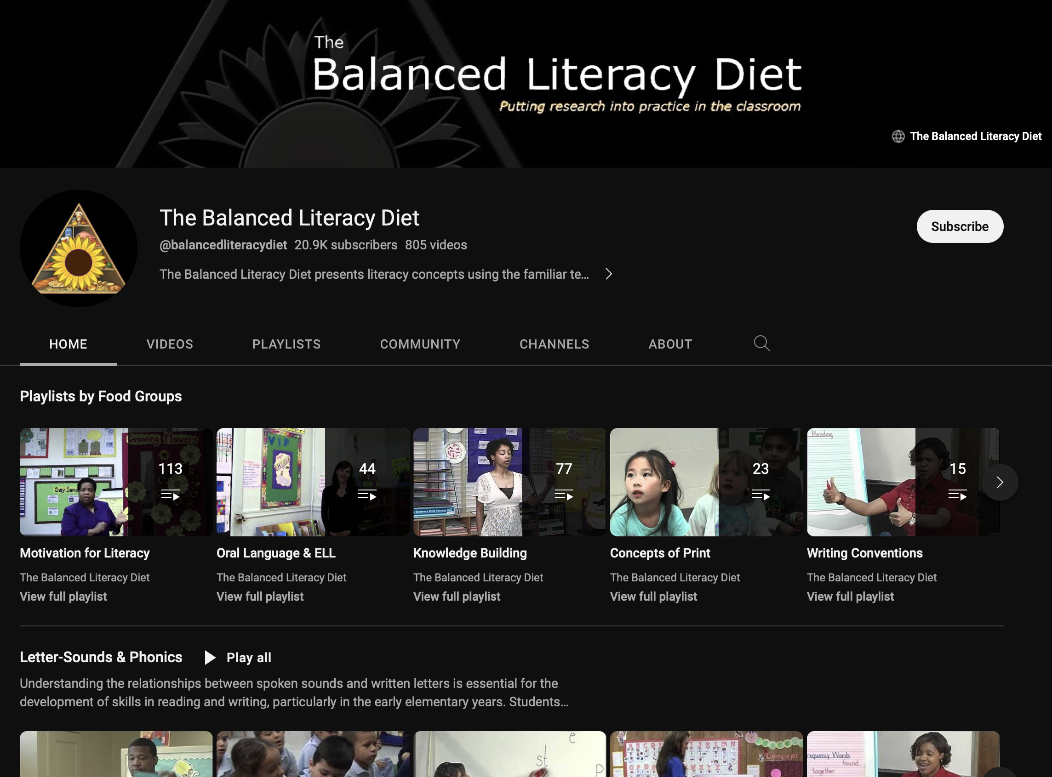
Balanced Literacy Diet
This is a fantastic Youtube channel for everything to do with literacy teaching. Lots of good techniques + strategies.

Slide 20
Class123 (NHN Edu Corp.)
Class123 is a free behavior management tool for your class. Fill your classroom with warm praises. Start with Class123!
https://class123.ac/ (service down)
https://www.youtube.com/watch?v=G5b2_1G3LdE

Slide 21
Class123
https://youtu.be/on2tqv3qu5s

Slide 22
Class Dojo is a similar service.

Slide 23
The most interesting topic today. Why?!

Slide 24
What is TPR? = Total Physical Response
physical movement is used to react to verbal input
“Listen and respond”
best with young/beginner students supported by other methods
can be used with expressions, vocabulary, grammar, stories, songs, role plays and so on

Slide 25
Total Physical Response
Why is TPR effective?
Focus on input
Focus on comprehension
Focus on meaning
Listening before production
Similar to natural acquisition
Acquisition (unconscious) over learning (conscious)
Reduces stress and inhibition
Teacher can check responses

Slide 26
Total Physical Response
How to use in the classroom…
T/F or guessing games (e.g. vocabulary)
Team games (competition or cooperation)
Speed games (time limit)
Use with other materials (flashcards, realia…)
Acting and retelling stories
Checking comprehension of songs

Slide 27
Example with grammar focus
Clapping
Game
one dog
two dogs
noticing + TPR
I saw a…
I saw some…
tiger
bear
bird
cow
one cat
two cats

Slide 28
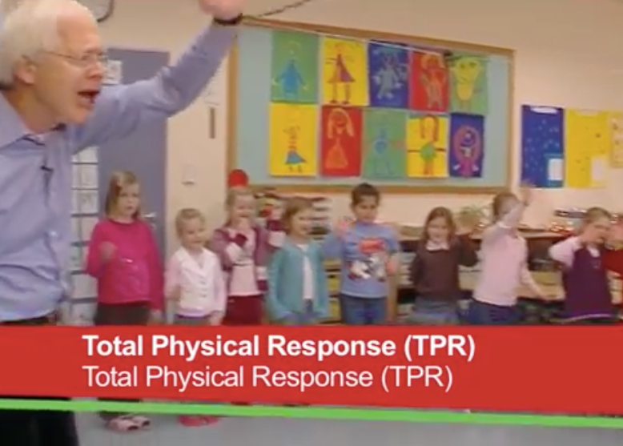
What does the teacher do differently at the beginning and at the end of the TPR activity?
How is TPR used as a step within the lesson?
https://www.youtube.com/watch?v=bkMQXFOqyQA

Slide 29
What does the teacher do differently at the beginning and at the end of the TPR activity?
How is TPR used as a step within the lesson?

Slide 30
What does the teacher do differently at the beginning and at the end of the TPR activity?
Say expression and show the actions
Say expression without showing action (take away scaffolding)
Mix the order of expressions
(Not included) Ask a student to say the expression
How is TPR used as a step within the lesson?
TPR is a scaffolding step to introduce the textbook expressions before opening the textbook. This has the benefit of pre-teaching meaning and giving exposure before the textbook listening activity.

Slide 31
TPR
Let’s mime ‘Buying ice cream’ with TPR
What do we do? 1, 2, 3, 4?
How to do this action game:
1. Choose a situation and the commands
2. Make a list
3. Show the action and say the command
4. Repeat the actions several times
5. Stop doing the actions to check learners understand

Slide 32
www.readingrockets.org
Task: go to https://www.readingrockets.org/strategies
Choose one of the tasks you are unfamiliar with. Take a look and then describe the task to a partner.

Slide 33
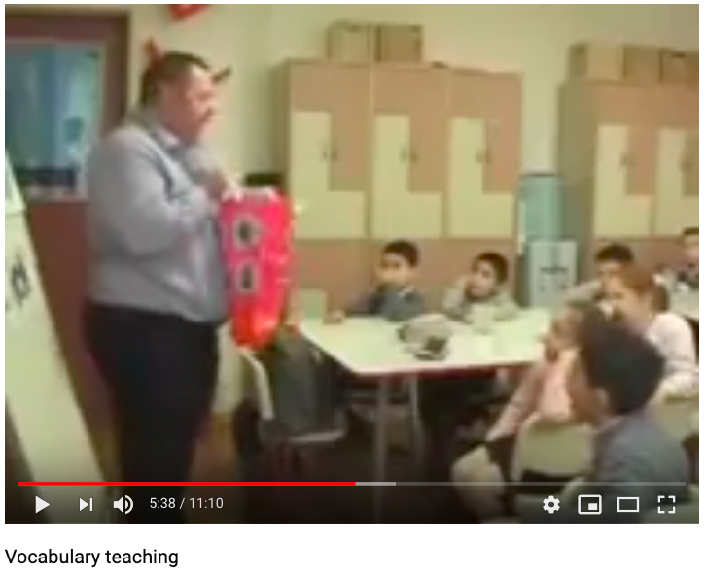
Analyze a lesson by an experienced teacher
TESOL for Young Learners

Slide 34
We are going to watch the beginning part of a lesson by teacher trainer Raymond Kerr.
What can we learn from this video?
Analyzing an experienced teacher
Classroom English
Setting context
Using flashcards
Teaching vocabulary
Teaching grammar
Scaffolding
Listening activities
Organising the steps of a lesson

Slide 35
https://www.youtube.com/watch?v=W8e6Ld4sQks

Slide 36
Questions to think about…
How does he set the context of the lesson? (contextualization)
How does he arouse students’ curiosity?
How does he implicitly teach grammar?
How does he organize the class into groups?
How does he continually review the words?
How does he get the students to use their bodies?
Any other aspects of his teaching or lesson plan that you noticed?
Analyzing an experienced teacher
https://youtu.be/W8e6Ld4sQks?t=72

Slide 37
1. How does he set the context of the lesson? (contextualization)
“Today is a special day for me.”
“What day is it?”
“How old do you think I am?”
“This is my birthday bag”
Context: Birthday
Topic: Toys
Analyzing an experienced teacher

Slide 38
2. How does he arouse students’ curiosity?
“Birthday bag"
Magic bag / Magic box - Mystery bag / Mystery box
Analyzing an experienced teacher

Slide 39
3. How does he implicitly teach grammar?
“In my bag I have a toy plane, a robot, a balloon”
= implicitly teaching indefinite articles
INDUCTIVE
Analyzing an experienced teacher

Slide 40
4. How does he organize the class into groups?
“Listen and remember your number-
1, 2, 1, 2…”
Analyzing an experienced teacher

Slide 41
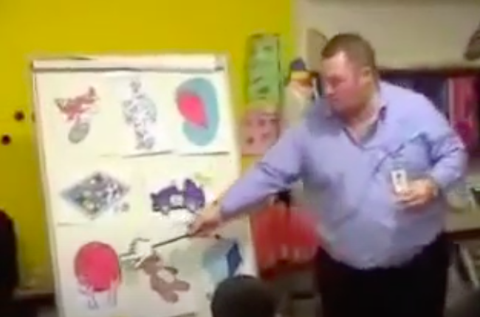
5. How does he continually review the words?
Analyzing an experienced teacher

Slide 42
6. How does he get the students to use their bodies?
Listen and hold up Listen and do a dance
Analyzing an experienced teacher

Slide 43
7. Any other aspects of his teaching or lesson plan that you noticed?
Analyzing an experienced teacher

Slide 44
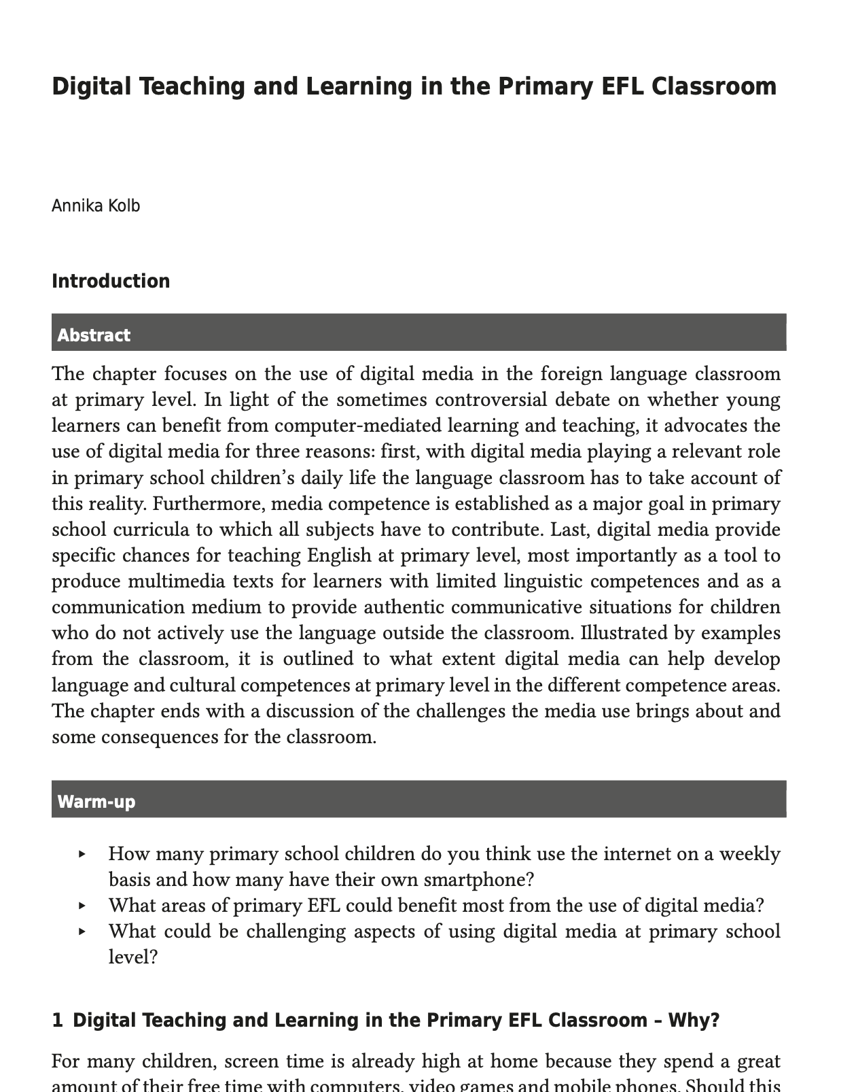
Reading assignment due week 7 (April 16)
See my website / discussion board.

