Slide 1
Listening & Speaking
for Young Learners
Review
Reading review
Technology in education
About next week
Email: edpovey@hotmail.co.uk
Website: edwardtesol.com

Slide 2
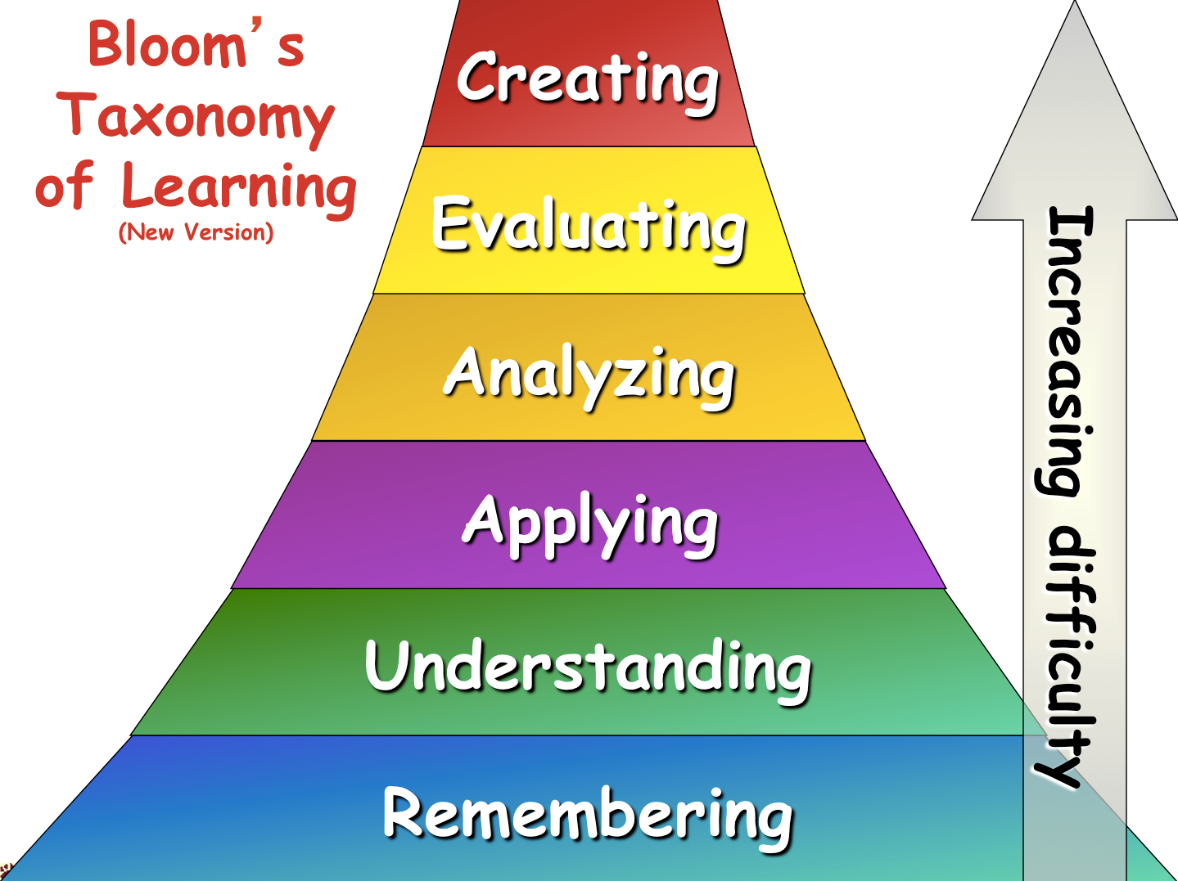
https://projects.coned.ncsu.edu/opd/ESL/pdf/Sarah Siddique - BT Quick Flip Questions.pdf

Slide 3
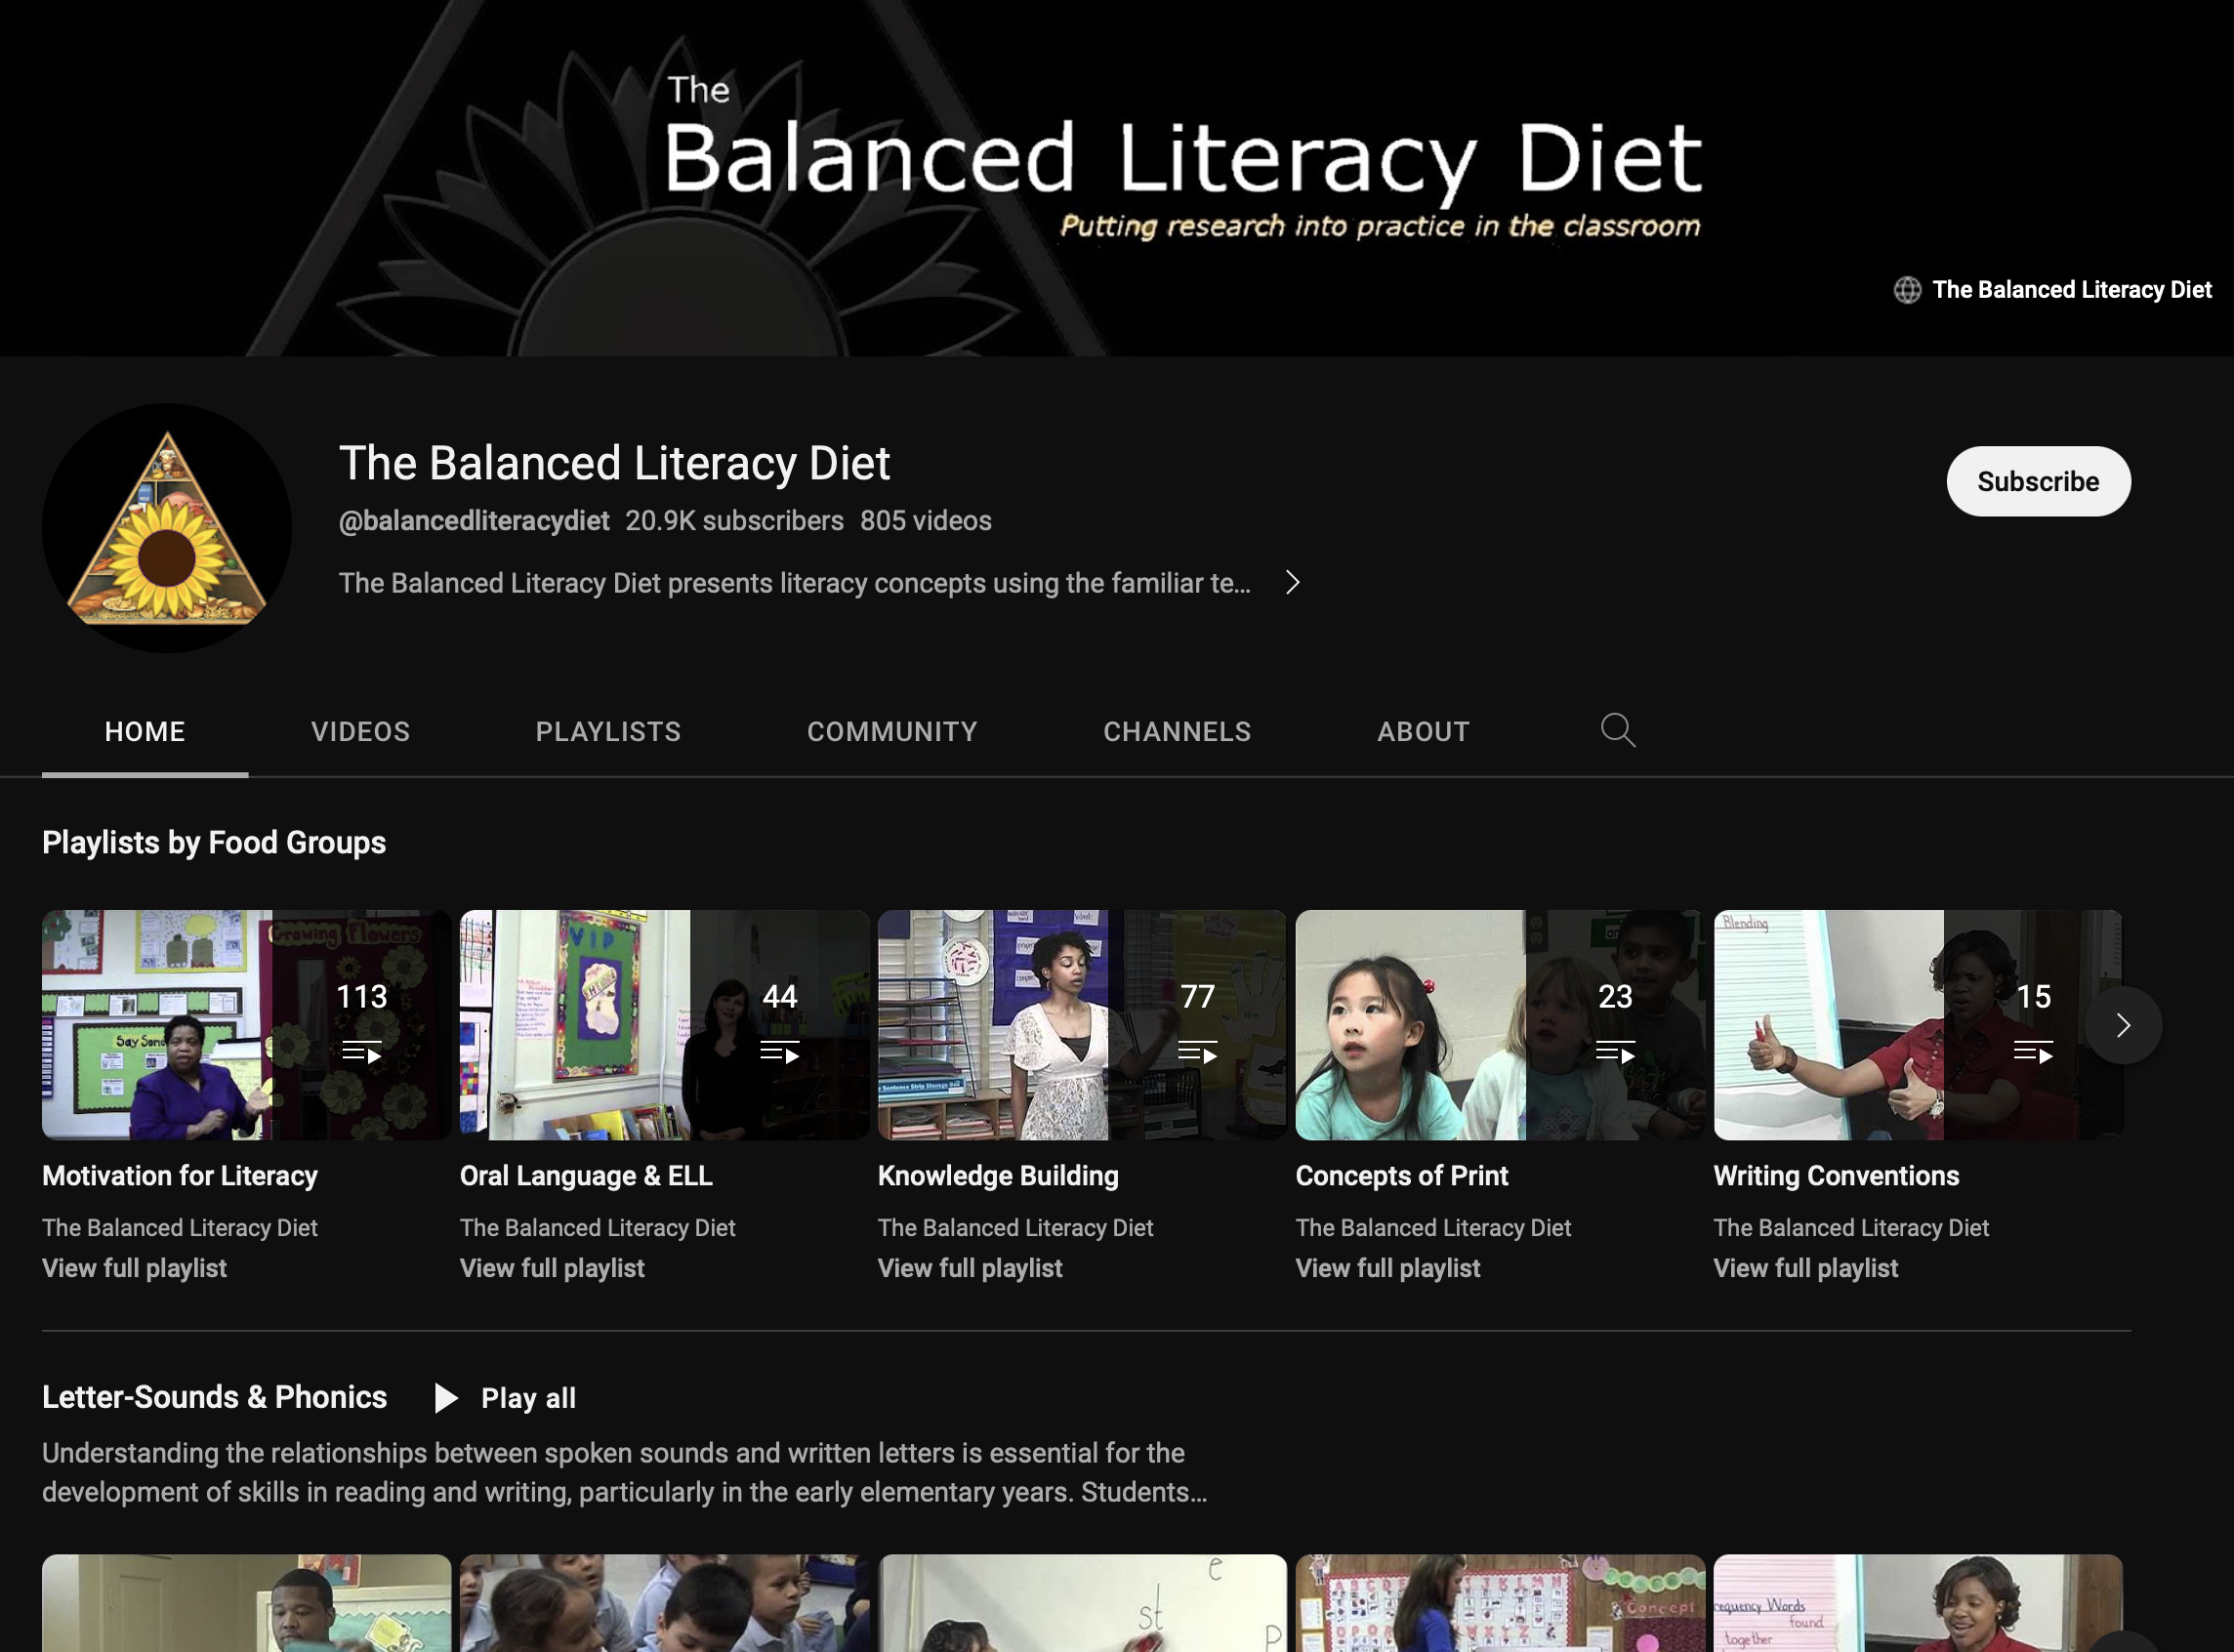
Balanced Literacy Diet
This is a fantastic Youtube channel for everything to do with literacy teaching. Lots of good techniques + strategies.

Slide 4
Class123 (NHN Edu Corp.)
Class123 is a free behavior management tool for your class. Fill your classroom with warm praises. Start with Class123!
https://class123.ac/
https://www.youtube.com/watch?v=G5b2_1G3LdE

Slide 5
Class123
https://youtu.be/on2tqv3qu5s

Slide 6
Class Dojo is a similar service.

Slide 7
Fields of Educational Technology
Online (distance) learning
Learning Management Systems
Mobile Learning
AI
VR / AR
Metaverse / Virtual worlds / Virtual learning
Web 3.0
Game-based learning / Gamification
Adaptive learning
…and more

Slide 8
Questions
What are you experiences of using technology in education? (as a learner or as a teacher / with young learners, or any other age group)
Choose one topic from the reading. What are your experiences or opinions about it?
What do you think are some technological developments that will change education in the next 10 years?

Slide 9
EDUCATIONAL
TECHNOLOGY

Slide 11
Digital identity + avatars
Unique and verifiable digital identity for use online (Web 3.0?)

Slide 12
Game avatars

Slide 13
https://www.youtube.com/watch?v=ipAWPU9WlMg

Slide 14
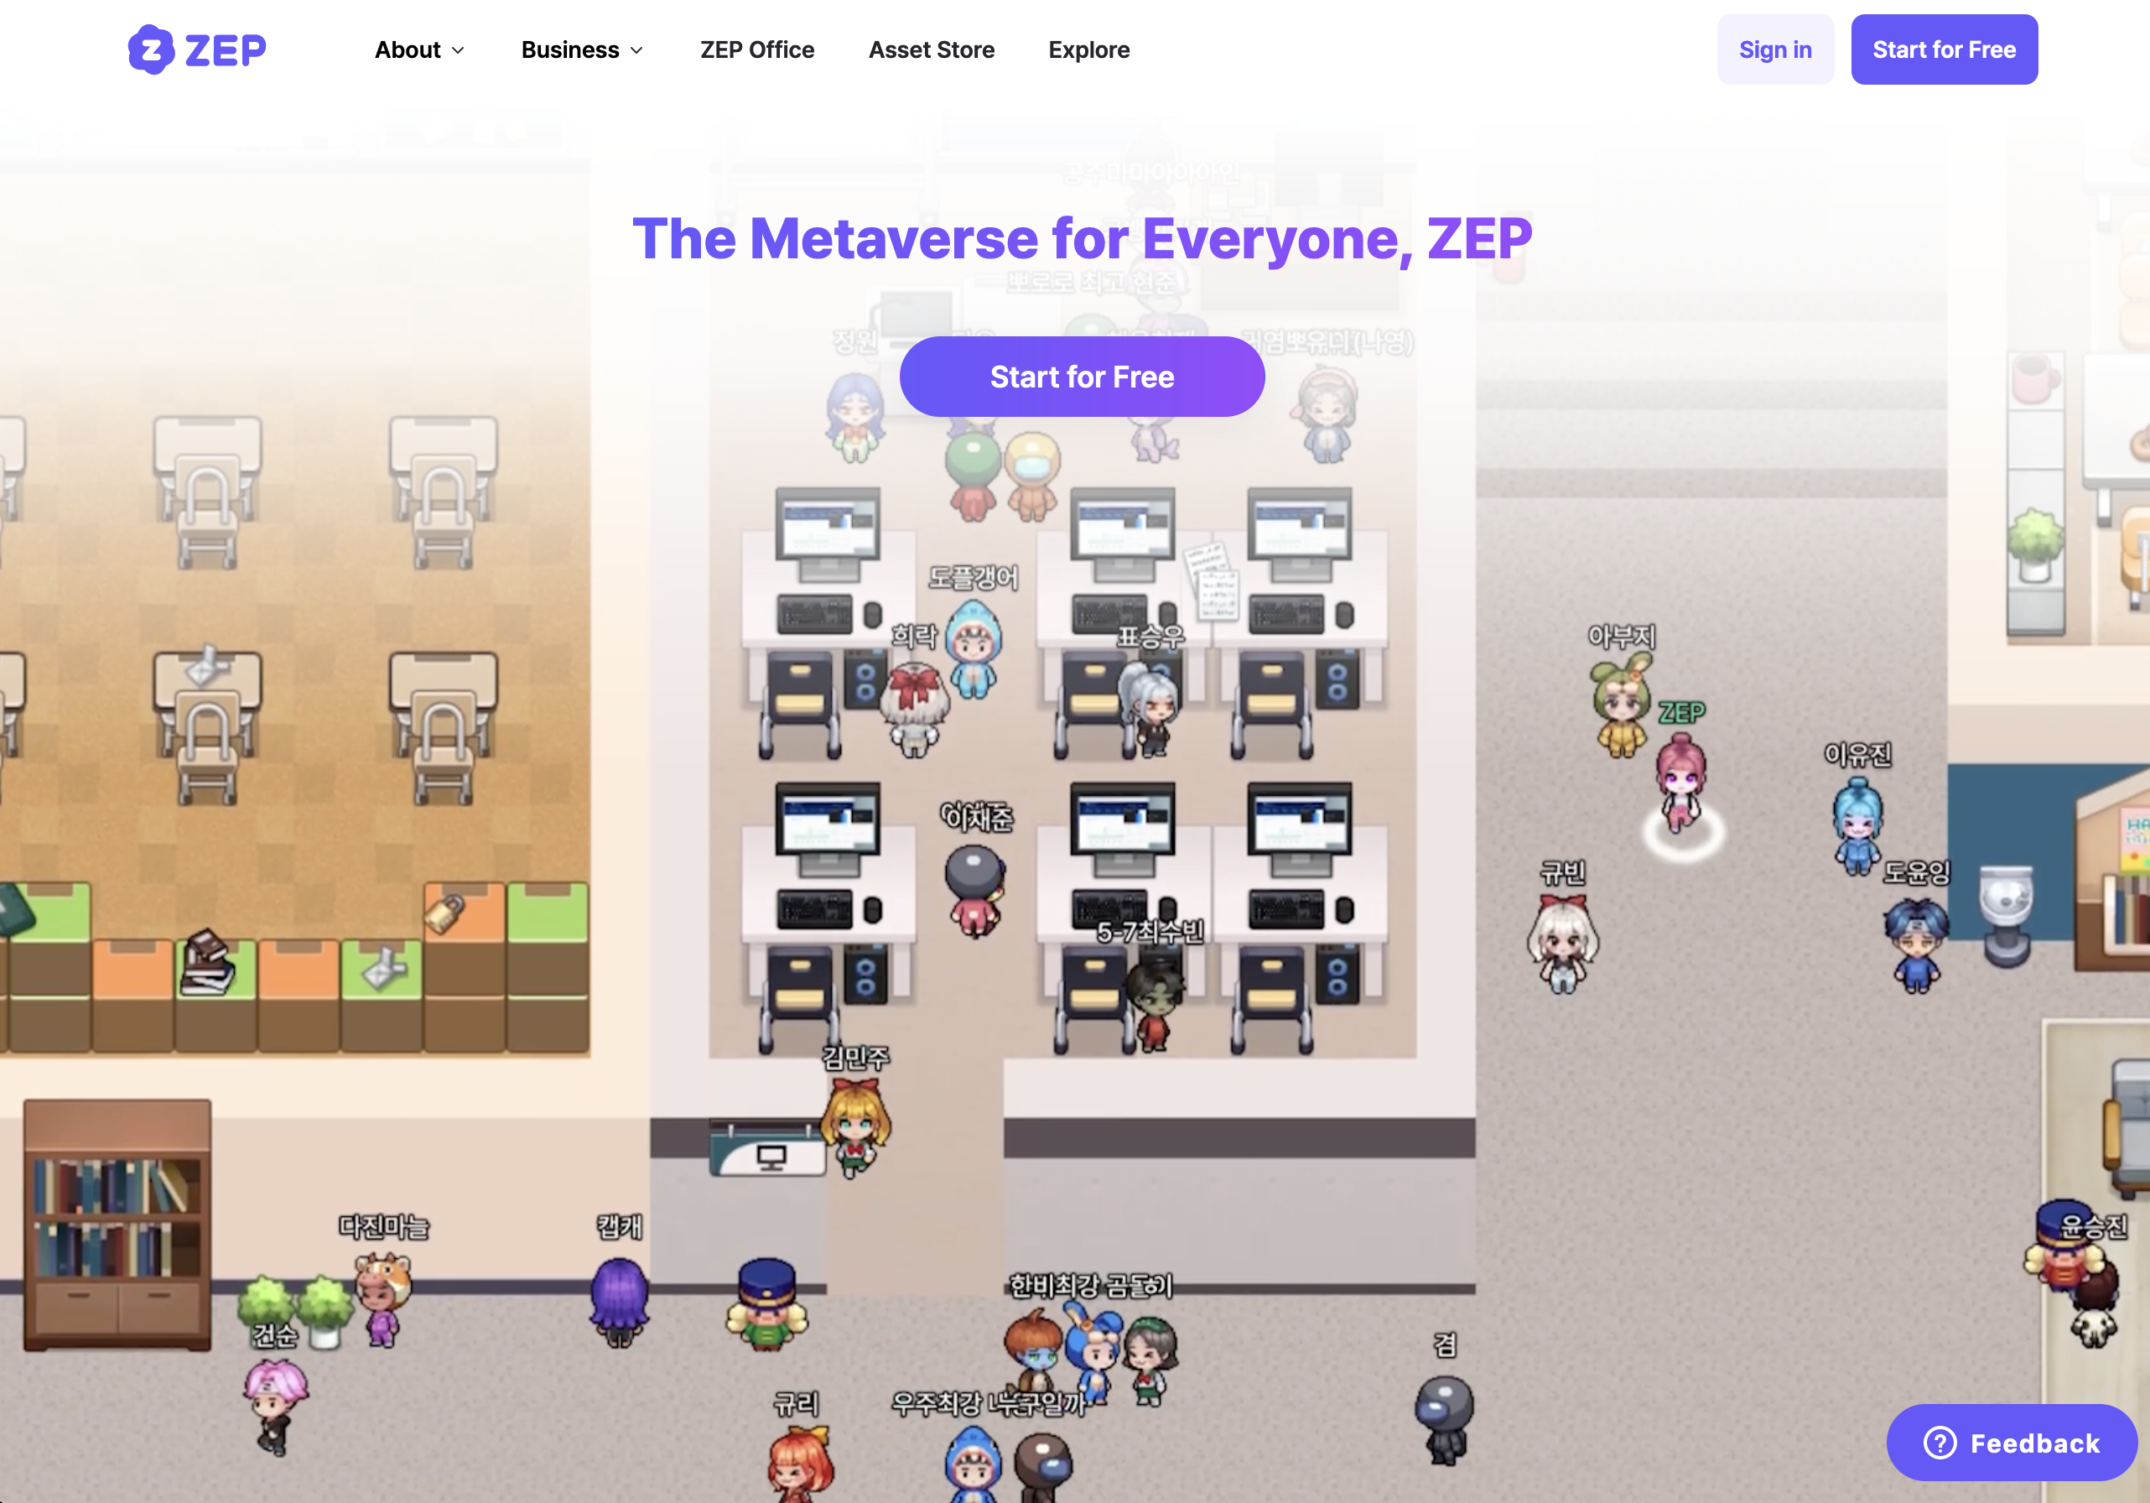
zep.us

Slide 16
RakugakiAR app
Point the camera.
Move it until the drawing has a pink box outline.
Press the pink “scan” button.

Slide 17
Quivervision app
AR learning app.

Slide 18
Online student response systems
www.kahoot.it https://create.kahoot.it

Slide 19
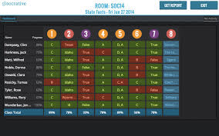
Online student response systems
www.socrative.com

Slide 20
www.educandy.com

Slide 21
What is ‘blended learning’?

Slide 22
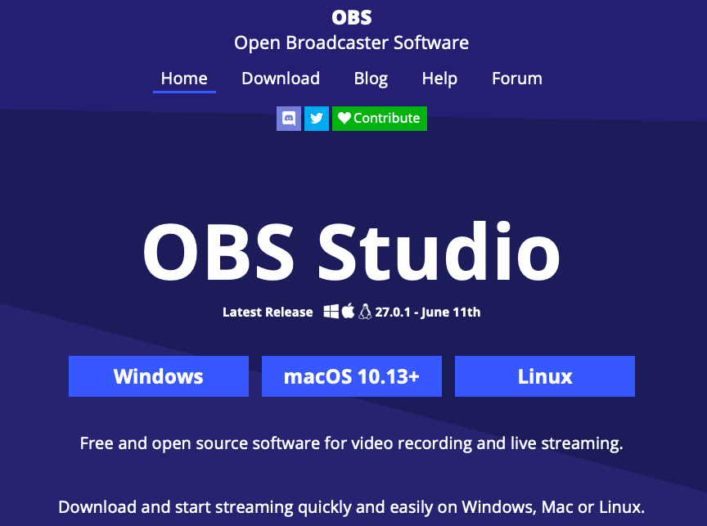
https://obsproject.com/
OBS Studio is a free broadcasting software.
It’s easy to use, but when you first open the software you need to set up the audio and video input.

Slide 23
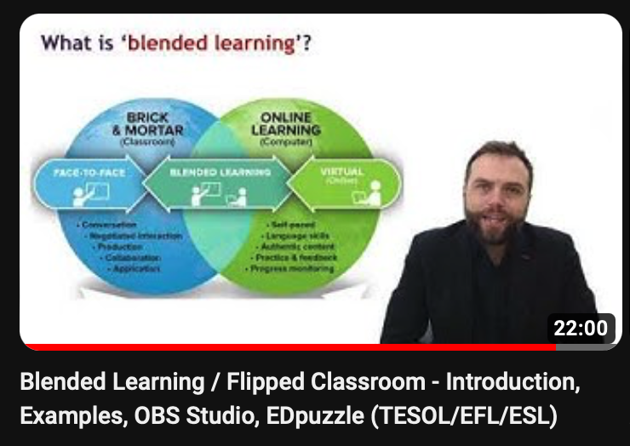
https://www.youtube.com/watch?v=SBMDsA8OuFk

Slide 24
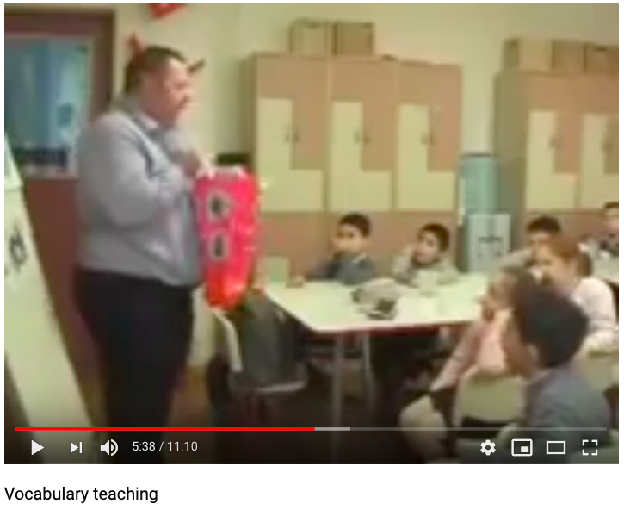
Analyze a lesson by an experienced teacher
TESOL for Young Learners

Slide 25
We are going to watch the beginning part of a lesson by teacher trainer Raymond Kerr.
What can we learn from this video?
Analyzing an experienced teacher
Classroom English
Setting context
Using flashcards
Teaching vocabulary
Teaching grammar
Scaffolding
Listening activities
Organising the steps of a lesson

Slide 26
https://www.youtube.com/watch?v=W8e6Ld4sQks

Slide 27
Questions to think about…
How does he set the context of the lesson? (contextualization)
How does he arouse students’ curiosity?
How does he implicitly teach grammar?
How does he organize the class into groups?
How does he continually review the words?
How does he get the students to use their bodies?
Any other aspects of his teaching or lesson plan that you noticed?
Analyzing an experienced teacher
https://youtu.be/W8e6Ld4sQks?t=72

Slide 28
1. How does he set the context of the lesson? (contextualization)
“Today is a special day for me.”
“What day is it?”
“How old do you think I am?”
“This is my birthday bag”
Context: Birthday
Topic: Toys
Analyzing an experienced teacher

Slide 29
2. How does he arouse students’ curiosity?
“Birthday bag"
Magic bag / Magic box - Mystery bag / Mystery box
Analyzing an experienced teacher

Slide 30
3. How does he implicitly teach grammar?
“In my bag I have a toy plane, a robot, a balloon”
= implicitly teaching indefinite articles
INDUCTIVE
Analyzing an experienced teacher

Slide 31
4. How does he organize the class into groups?
“Listen and remember your number-
1, 2, 1, 2…”
Analyzing an experienced teacher

Slide 32
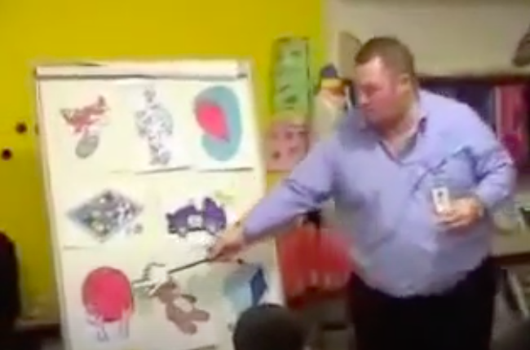
5. How does he continually review the words?
Analyzing an experienced teacher

Slide 33
6. How does he get the students to use their bodies?
Listen and hold up Listen and do a dance
Analyzing an experienced teacher

Slide 34
7. Any other aspects of his teaching or lesson plan that you noticed?
Analyzing an experienced teacher

Slide 35
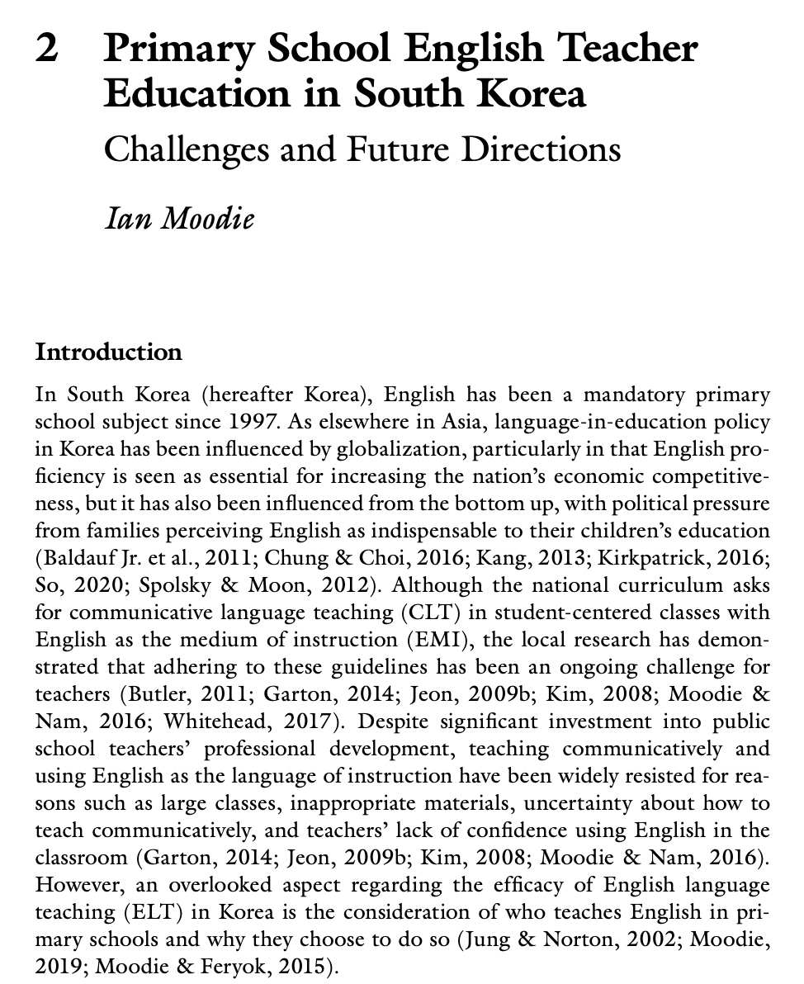
No reading homework for next week.
Next reading homework will be for week 9.

Slide 36
Task:
Choose one of the technology services we have discussed this week, or another service that you know.
Create a teachers account if you need to. Create something using the service. For example a quiz (Socrative), an activity (Educandy), a video (OBS Studio), etc. Try it at home or with your students.
Be ready to share next week.
www.kahoot.it (student) https://create.kahoot.it
www.educandy.com
www.socrative.com
https://obsproject.com/
zep.us

